Slide 1
Gaussian Processes
Scientific Machine Learning
Sebastian Klein

Slide 2
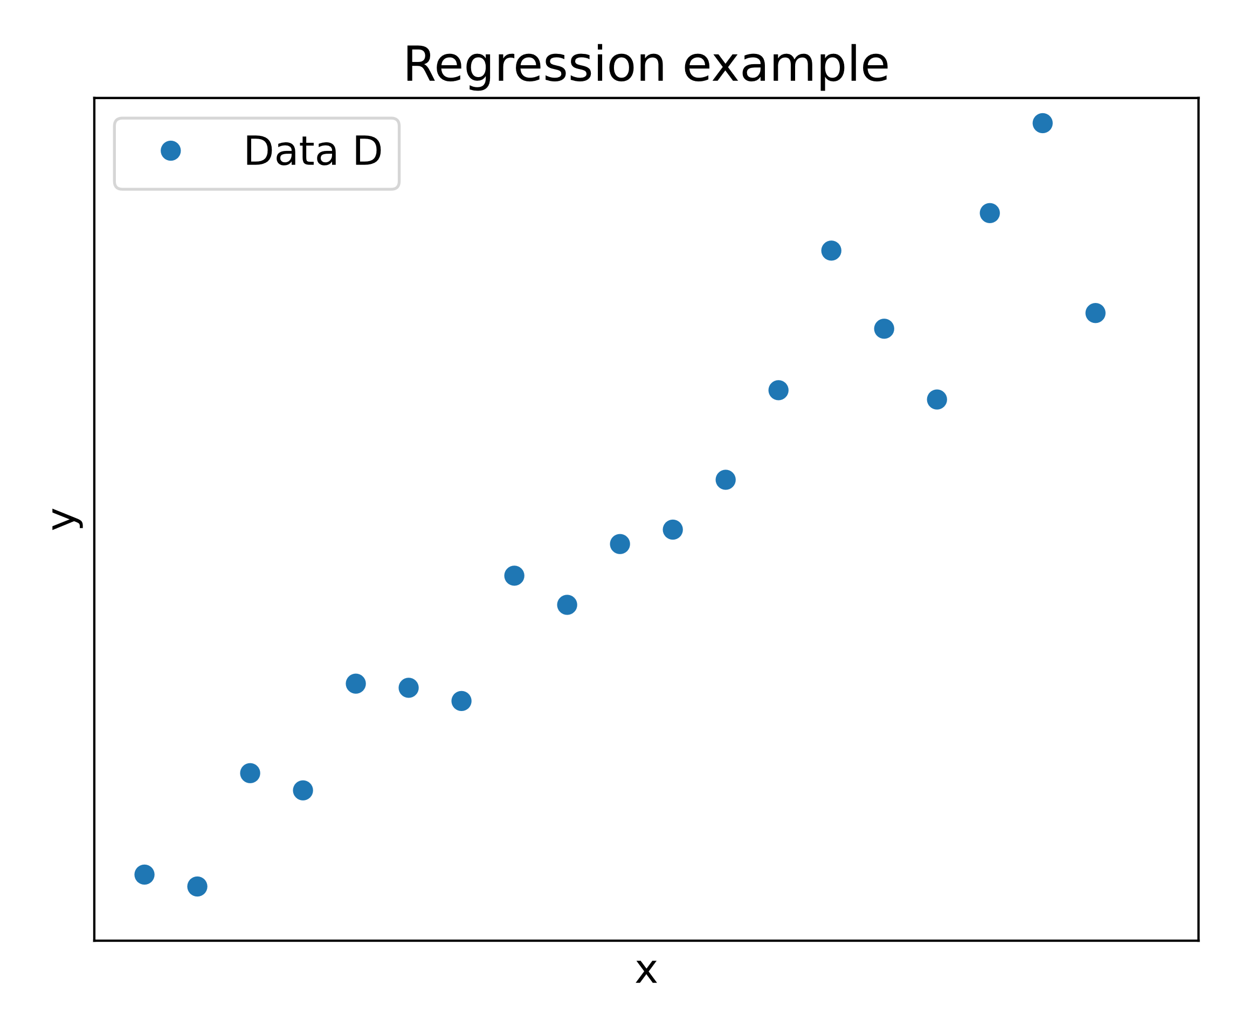
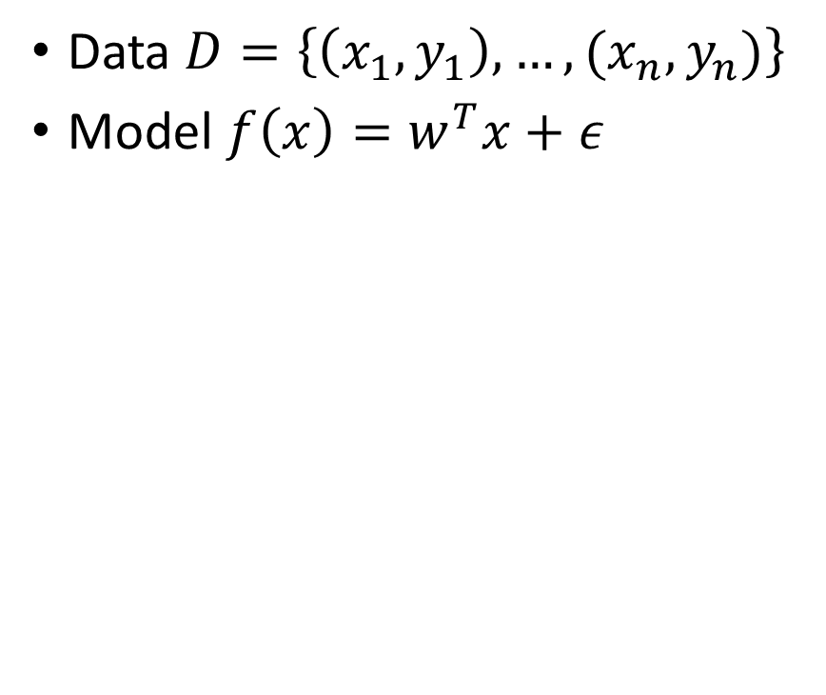
Motivation – Regression problems [1]
Data $D=\left\{\left(x_{1},y_{1}\right),…,(x_{n},y_{n})\right\}$
Model $f\left(x\right)=w^{T}x+ε$
Notes:
$w^{T}x+ε$ – epsilon = noise, w - model parameters
Aim Learn parameters w to make predictions about the distribution underlying the Data

Slide 3
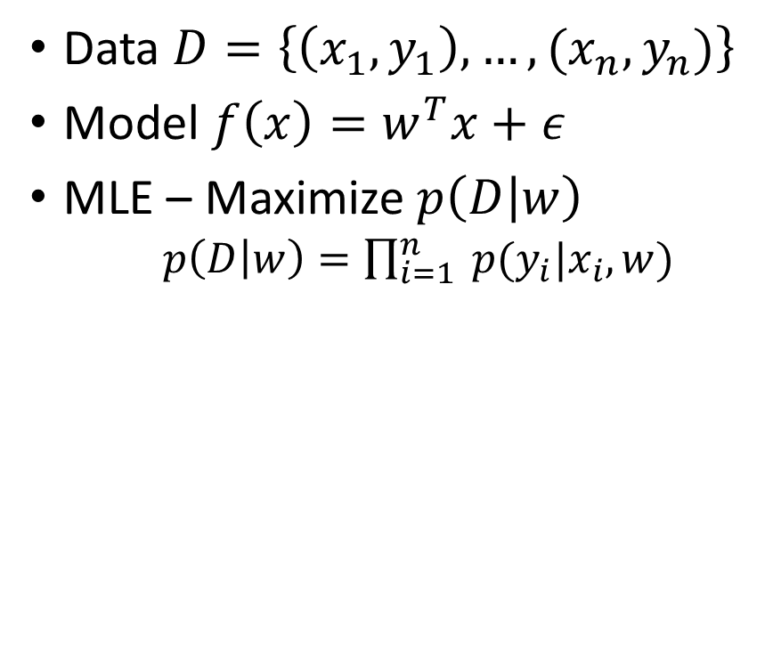
Motivation – Regression problems [1]
Data $D=\left\{\left(x_{1},y_{1}\right),…,(x_{n},y_{n})\right\}$
Model $f\left(x\right)=w^{T}x+ε$
MLE – Maximize$p\left(D | w\right)$
$p\left(D | w\right)=\prod_{i=1}^{n}{ p(y_{i}|x_{i}, w)}$
Notes:
$w^{T}x+ε$ – epsilon = noise, w - model parameters
Aim Learn parameters w
MLE - Maximum Likelihood Estimation
-> max probability of Data $p\left(D | w\right)$ for a parameter $w$
$→ p(y_{i}|x_{i}, w$) how likely is it that an x_i gives rise to the y_i with the parameter w

Slide 4
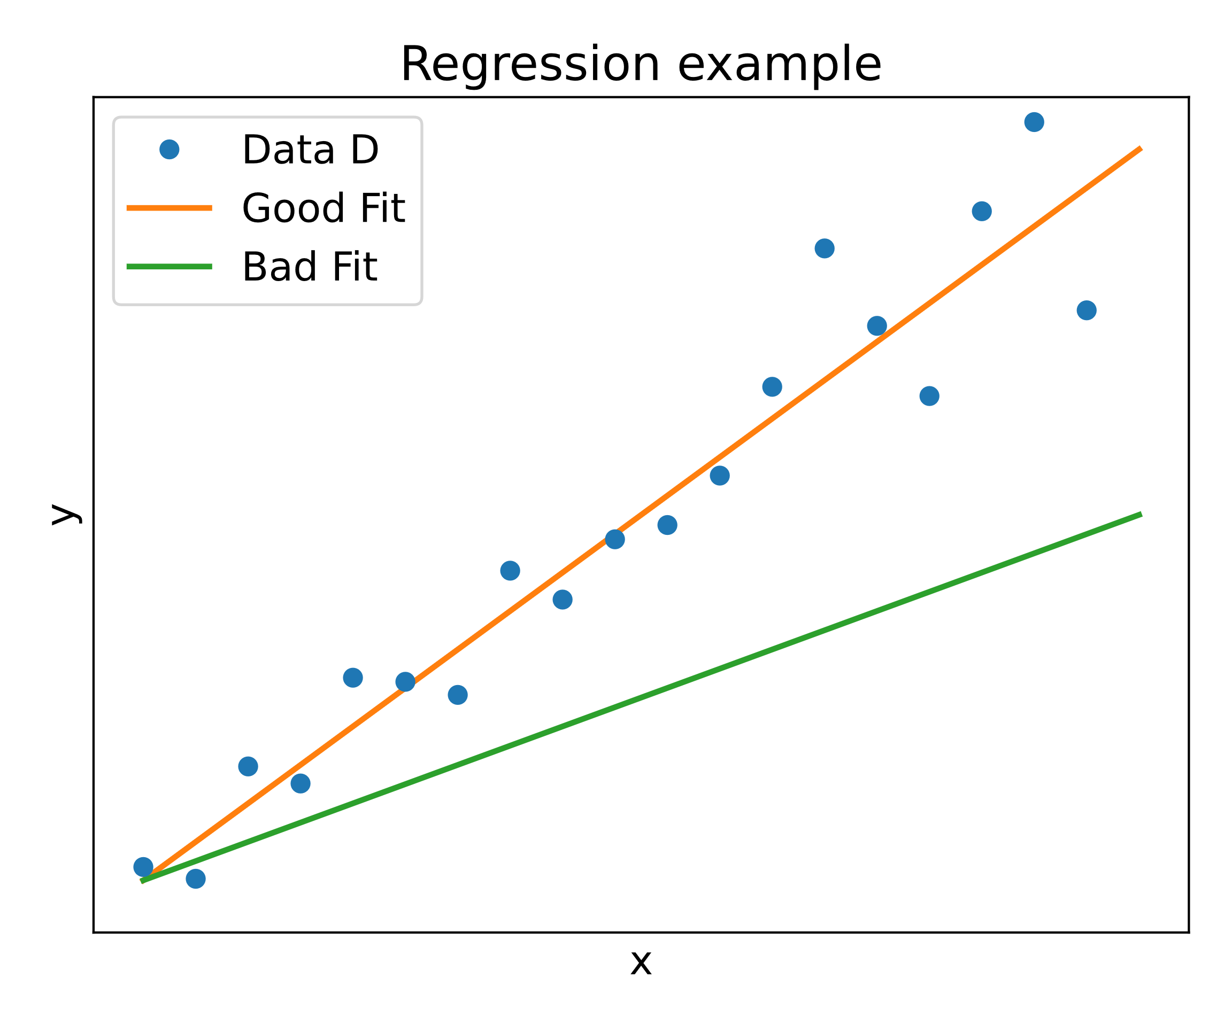
Motivation – Regression problems [1]
Data $D=\left\{\left(x_{1},y_{1}\right),…,(x_{n},y_{n})\right\}$
Model $f\left(x\right)=w^{T}x+ε$
MLE – Maximize$p\left(D | w\right)$
$p\left(D | w\right)=\prod_{i=1}^{n}{ p(y_{i}|x_{i}, w)}$
Notes:
$w^{T}x+ε$ – epsilon = noise, w - model parameters
Aim Learn parameters w
MLE - Maximum Likelihood Estimation
-> max probability of Data $p\left(D | w\right)$ for a parameter $w$
$→ p(y_{i}|x_{i}, w$) how likely is it that an x_i gives rise to the y_i with the parameter w

Slide 5
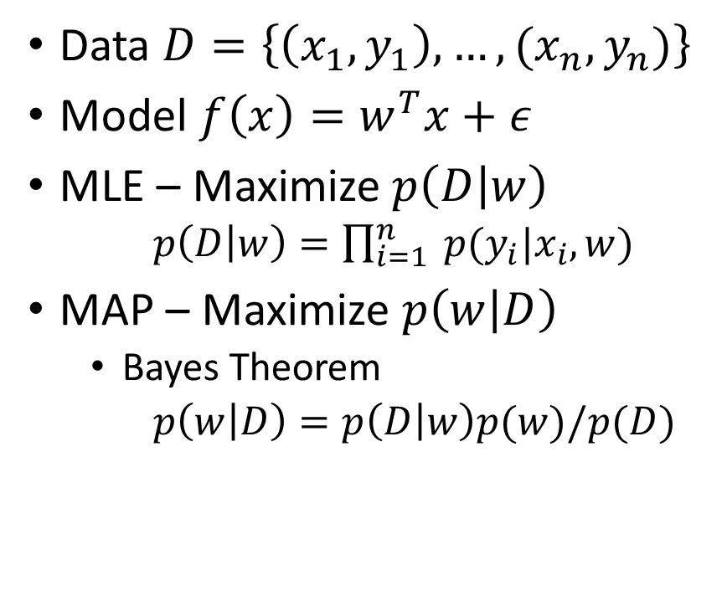
Motivation – Regression problems [1]
Data $D=\left\{\left(x_{1},y_{1}\right),…,(x_{n},y_{n})\right\}$
Model $f\left(x\right)=w^{T}x+ε$
MLE – Maximize$p\left(D | w\right)$
$p\left(D | w\right)=\prod_{i=1}^{n}{ p(y_{i}|x_{i}, w)}$
MAP – Maximize $p\left(w | D\right)$
Bayes Theorem
$p\left(w | D\right)=p\left(D | w\right)p(w)/p(D)$
Notes:
$p(y_{i}|x_{i}, w$) how likely is it that the x_i gives rise to the y_i with the parameter w
Aim Learn parameters W
MLE - Maximum Likelihood Estimation - max probability of Data $p\left(D | w\right)$ for a parameter $w$
MAP- Maximum a posteriori
Prior = $p\left(w\right)$

Slide 6
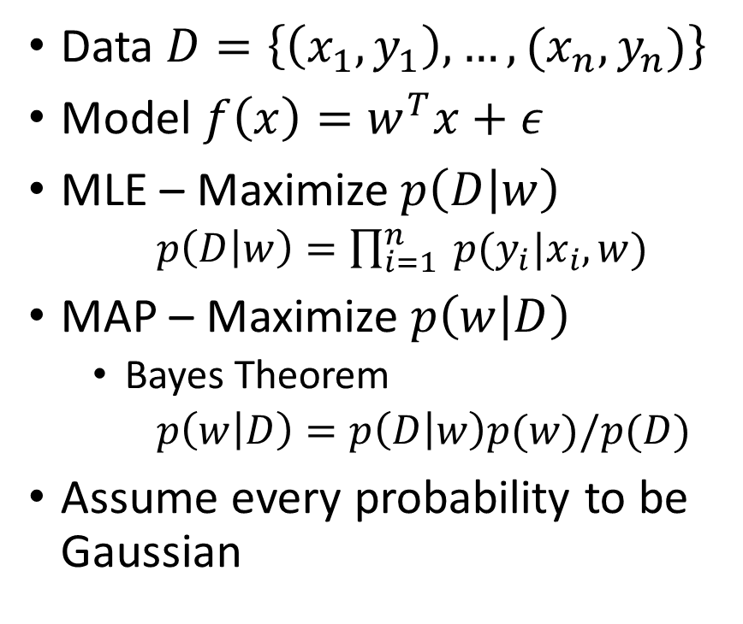
Motivation – Regression problems [1]
Data $D=\left\{\left(x_{1},y_{1}\right),…,(x_{n},y_{n})\right\}$
Model $f\left(x\right)=w^{T}x+ε$
MLE – Maximize$p\left(D | w\right)$
$p\left(D | w\right)=\prod_{i=1}^{n}{ p(y_{i}|x_{i}, w)}$
MAP – Maximize $p\left(w | D\right)$
Bayes Theorem
$p\left(w | D\right)=p\left(D | w\right)p(w)/p(D)$
Assume every probability to be Gaussian
Notes:
MLE - Maximum Likelihood Estimation - max probability of Data $p\left(D | w\right)$ for a parameter $w$
MAP- Maximum a posteriori
$w^{T}x$, $ε$, p(D|w), gaussian distributed
Last line -> How do we come to the conclusion $p\left(w | D\right)\sim 𝒩(μ, Σ)$

Slide 7
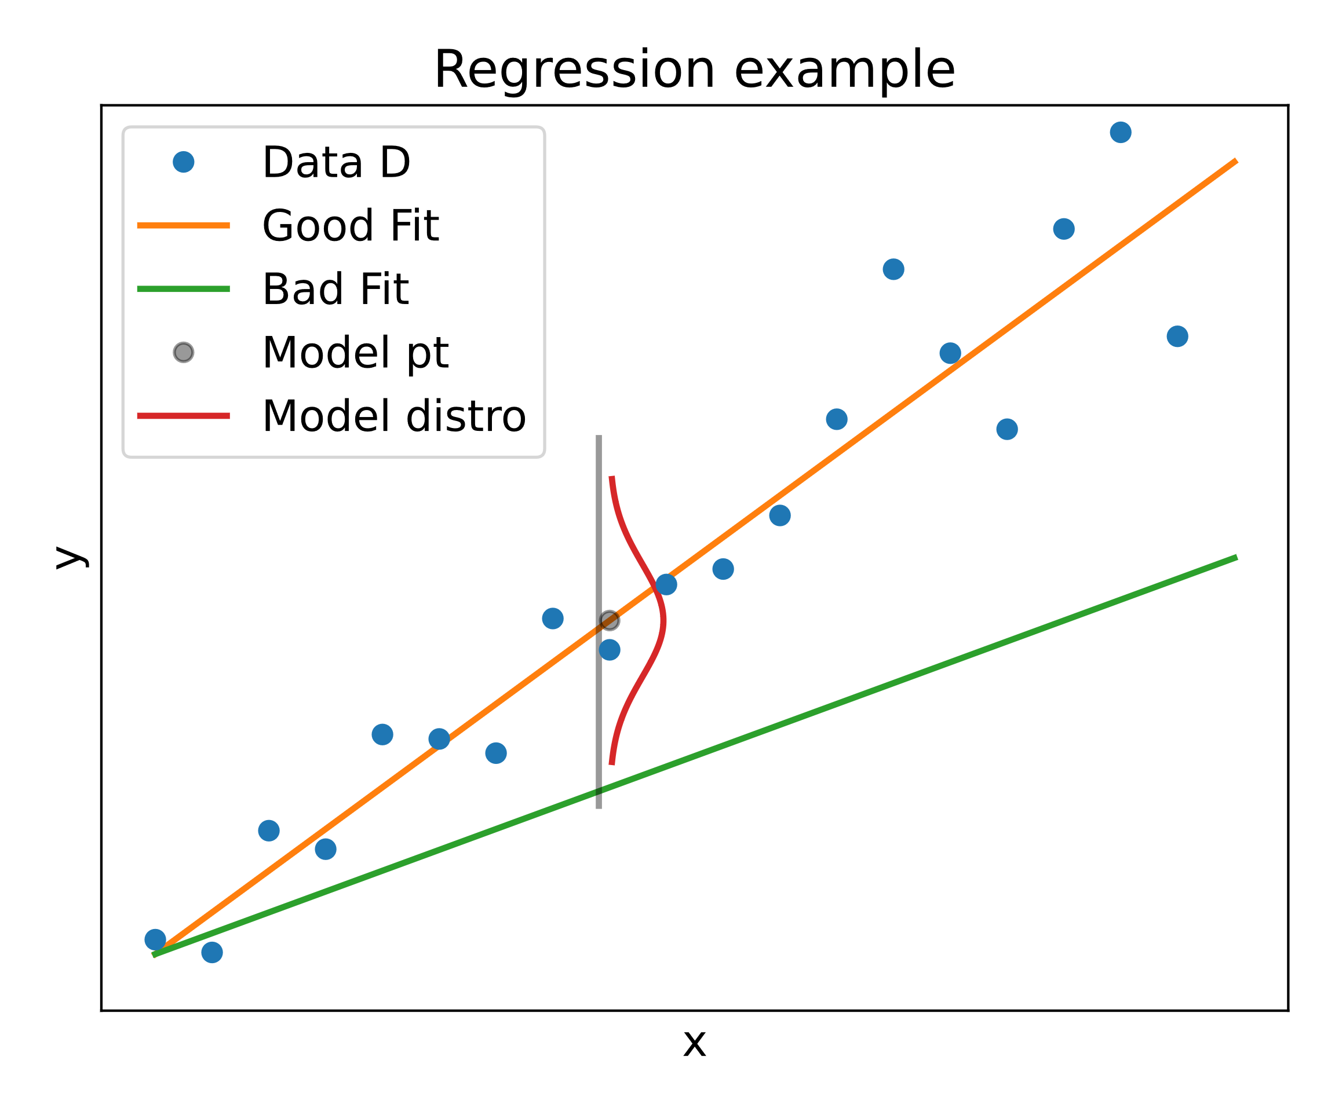
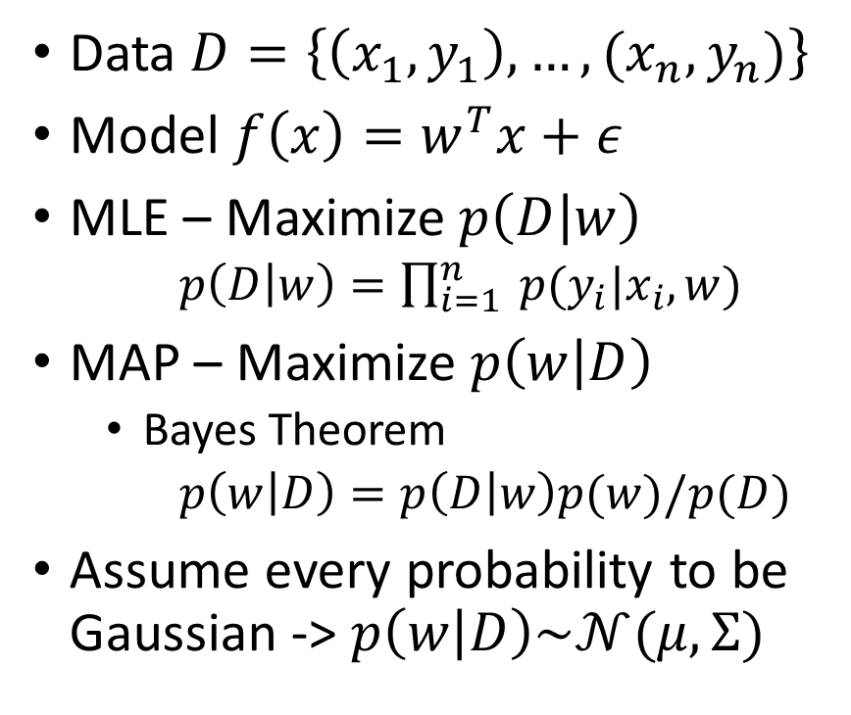
Motivation – Regression problems [1]
Data $D=\left\{\left(x_{1},y_{1}\right),…,(x_{n},y_{n})\right\}$
Model $f\left(x\right)=w^{T}x+ε$
MLE – Maximize$p\left(D | w\right)$
$p\left(D | w\right)=\prod_{i=1}^{n}{ p(y_{i}|x_{i}, w)}$
MAP – Maximize $p\left(w | D\right)$
Bayes Theorem
$p\left(w | D\right)=p\left(D | w\right)p(w)/p(D)$
Assume every probability to be Gaussian -> $p\left(w | D\right)\sim 𝒩(μ, Σ)$
Notes:
Not only get $p\left(w | D\right)$ but probability over all possible functions describing data -> Marginalization

Slide 8
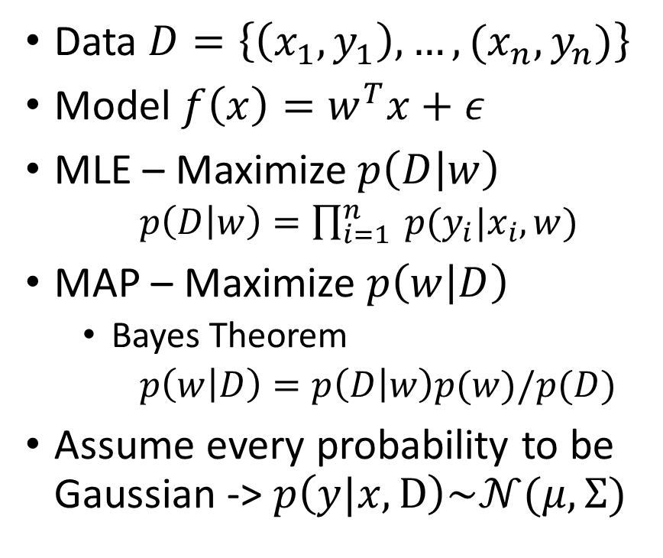
Motivation – Regression problems [1]
Data $D=\left\{\left(x_{1},y_{1}\right),…,(x_{n},y_{n})\right\}$
Model $f\left(x\right)=w^{T}x+ε$
MLE – Maximize$p\left(D | w\right)$
$p\left(D | w\right)=\prod_{i=1}^{n}{ p(y_{i}|x_{i}, w)}$
MAP – Maximize $p\left(w | D\right)$
Bayes Theorem
$p\left(w | D\right)=p\left(D | w\right)p(w)/p(D)$
Assume every probability to be Gaussian -> $p\left(y|x,D\right)\sim 𝒩(μ, Σ)$
Notes:
x test point -> Probablity $p\left(y|x,D\right)$ -> Distribution of y
-> No need to commit to a model -> Marginalized out the model

Slide 9
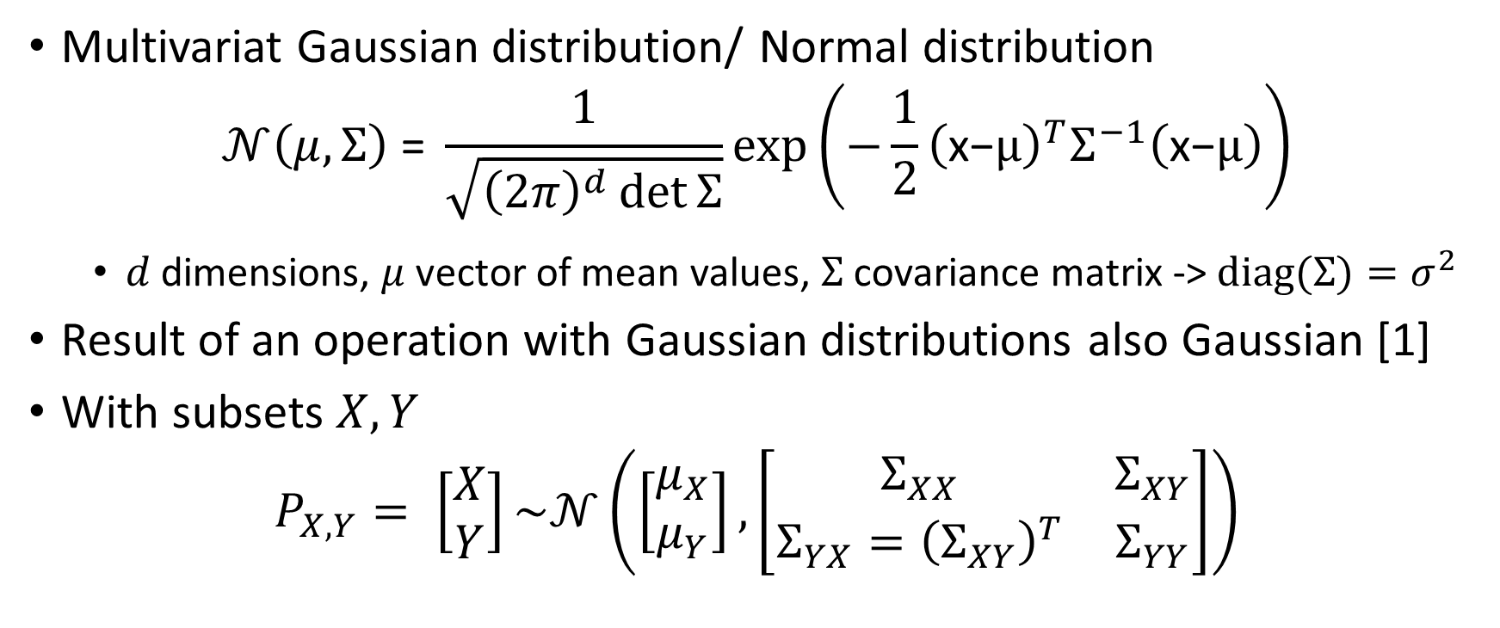
Intermezzo – Multivariate Gaussian[2]
Multivariat Gaussian distribution/ Normal distribution
$$𝒩\left(μ, Σ\right) \text{=} \frac{1}{\sqrt{{\left(2π\right)}^{d}\det{Σ}}}\text{exp}\left(−\frac{1}{2}{\left(\text{x}\text{−}μ\right)}^{T}Σ^{−1}\left(\text{x}\text{−}μ\right)\right)$$
$d$ dimensions, $μ$ vector of mean values, $Σ$ covariance matrix -> $diag(Σ)=σ^{2}$
Result of an operation with Gaussian distributions also Gaussian [1]
With subsets $X,Y$
$$P_{X,Y}= \left[\begin{matrix}X \\ Y\end{matrix}\right]\sim 𝒩\left(\left[\begin{matrix}μ_{X} \\ μ_{Y}\end{matrix}\right],\left[\begin{matrix}Σ_{XX} & Σ_{XY} \\ Σ_{YX}={\left(Σ_{XY}\right)}^{T} & Σ_{YY}\end{matrix}\right]\right)$$
Notes:
$σ^{2}$ is the variance
$σ$ is the standard deviation
Marginalization and Conditioning operating on subsets

Slide 10
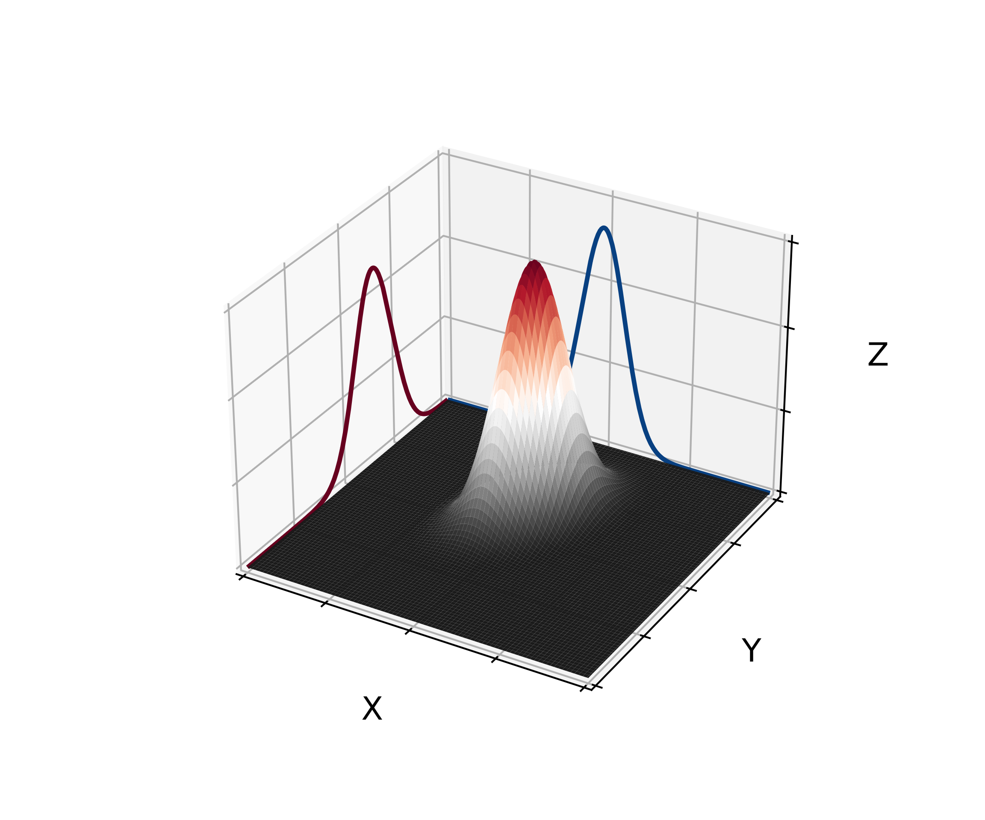
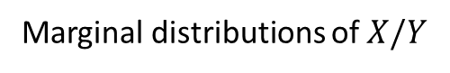
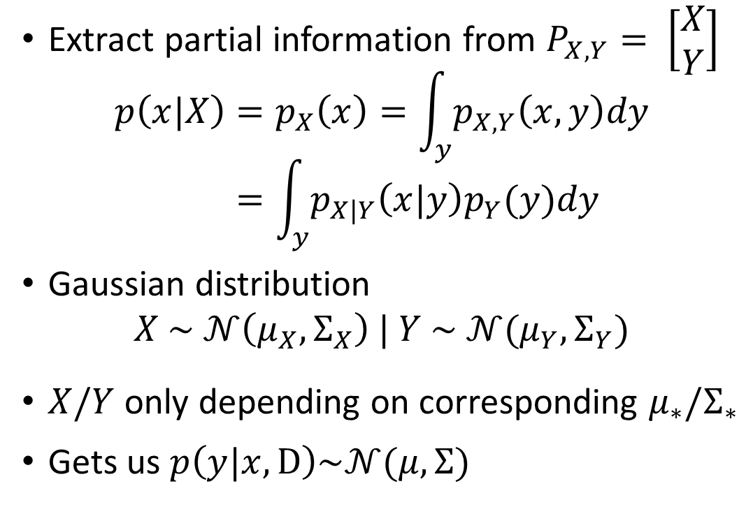
Intermezzo – Marginalization [2]
Extract partial information from $P_{X,Y}= \left[\begin{matrix}X \\ Y\end{matrix}\right]$
$$p\left(x|X\right)=p_{X}\left(x\right)=\int_{y}{p_{X,Y}\left(x,y\right)dy} \\ =\int_{y}{p_{X|Y}\left(x|y\right)p_{Y}(y)dy}$$
Gaussian distribution
$$X \sim 𝒩\left(μ_{X},Σ_{X}\right) | Y \sim 𝒩(μ_{Y},Σ_{Y})$$
$X/Y$only depending on corresponding $μ_{∗}/Σ_{∗}$
Gets us $p\left(y|x,D\right)\sim 𝒩(μ, Σ)$
Marginal distributions of $X/Y$
Notes:
Extract partial information “OR” Extract distribution of subsets
Marginalization tells us that the posterior distribution $p\left(y|x,D\right)$is also gaussian distributed with some mean and some covariance matrix

Slide 11
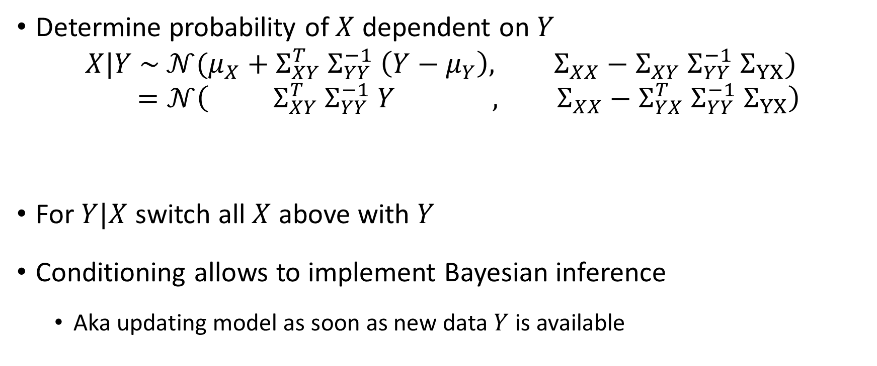
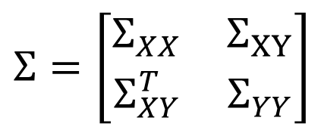
Intermezzo – Conditioning [2]
Determine probability of $X$ dependent on $Y$
$$X|Y \sim 𝒩(μ_{X}+Σ_{XY}^{T} Σ_{YY}^{−1} \left(Y−μ_{Y}\right), Σ_{XX}−Σ_{XY} Σ_{YY}^{−1} Σ_{YX}) \\ =𝒩\left( Σ_{XY}^{T} Σ_{YY}^{−1} Y , Σ_{XX}−Σ_{YX}^{T} Σ_{YY}^{−1} Σ_{YX}\right)$$
For $Y|X$ switch all $X$ above with $Y$
Conditioning allows to implement Bayesian inference
Aka updating model as soon as new data $Y$ is available
Mean
Covariance Matrix
$$Σ=\left[\begin{matrix}Σ_{XX} & Σ_{XY} \\ Σ_{XY}^{T} & Σ_{YY}\end{matrix}\right]$$
Notes:
Last line assume $μ_{Y}=0=μ_{X}$
Cornerstone of GP

Slide 12
Regression as Gaussian Process (GP) [2,9]
Goal: Predict values
How to predict values?
What is a prediction here?
Sample drawn from $𝒩\left(μ, Σ\right)$
Sample drawn from 𝒩(𝜇, Σ)
How get $𝒩(μ, Σ)$?
How get 𝒩(𝜇, Σ)?
Learn with training data $Y$
Learn with training data 𝑌
Predict value for test data $X$
Predict value for test data 𝑋
How to determine $μ$ and $Σ$?
How to determine 𝜇 and Σ?
Set $μ=0$
Set 𝜇=0
Simplifies conditioning to $X|Y \sim 𝒩\left(0, Σ_{XX}−Σ_{YX}^{T} Σ_{YY}^{−1} Σ_{YX}\right)$
Simplifies conditioning to 𝑋|Y ~𝒩(0, Σ_𝑋𝑋−Σ_𝑌𝑋^𝑇 Σ_𝑌𝑌^(−1) Σ_YX )
Characteristic of $𝒩(μ, Σ)$ solely determined by $Σ$
Characteristic of 𝒩(𝜇, Σ) solely determined by Σ
Know $p\left(y|x,D\right)\sim 𝒩(μ, Σ)$
Know 𝑝(𝑦|𝑥,D)~ 𝒩(𝜇, Σ)
Notes:
Later we can add back $μ≠0$

Slide 13
Regression as Gaussian Process [2,9]
Last result
How to determine the $Σ$’s?
How to determine the Σ’s?
$Σ=Cov\left(X,X^{′}\right)$ with $Cov\left(X,X^{′}\right)=k\left(x,x^{′}\right)$
Σ=𝐶𝑜𝑣(𝑋,𝑋^′ ) with 𝐶𝑜𝑣(𝑋,𝑋^′ )=𝑘(𝑥,𝑥^′ )
Evaluate $k\left(x,x^{′}\right)$ pairwise
Evaluate 𝑘(𝑥,𝑥^′ ) pairwise
Covariance function $k\left(x,x^{′}\right)$ also called kernel
Covariance function 𝑘(𝑥,𝑥^′ ) also called kernel
Can choose any kernel that is
Positive semidefinite
+
Symmetric
Combinations possible
$$𝒩\left(0, Σ_{XX}−Σ_{YX}^{T} Σ_{YY}^{−1} Σ_{YX}\right)$$
𝒩(0, Σ_𝑋𝑋−Σ_𝑌𝑋^𝑇 Σ_𝑌𝑌^(−1) Σ_YX )
Notes:
covariance function
as long as symmetry and pos. semidefinite combine

Slide 14
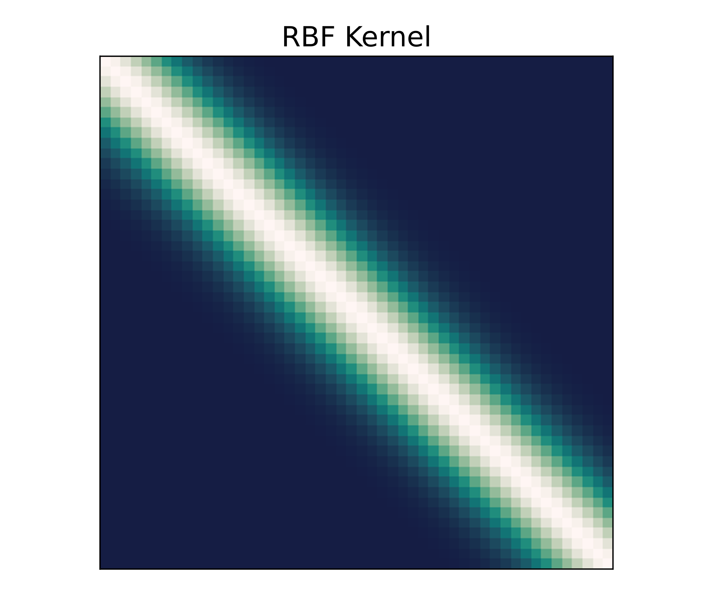
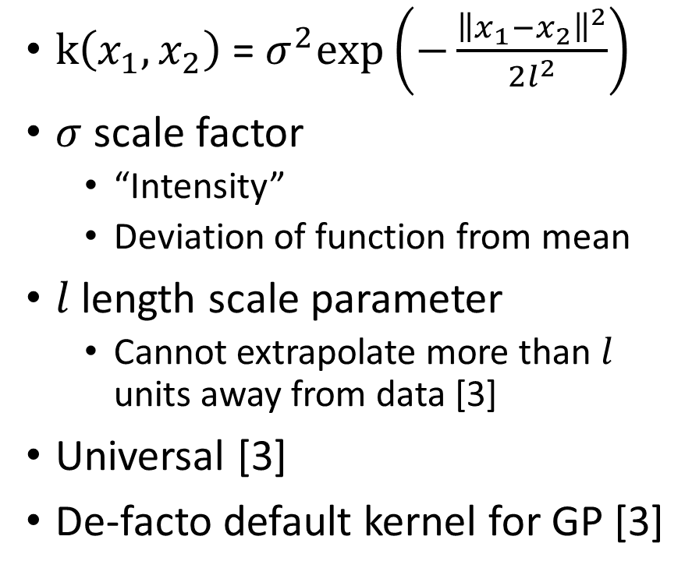
Kernels – RBF [3]
$\text{k}\left(x_{1},x_{2}\right) \text{=} σ^{2}\text{exp}\left(−\frac{{\left\|x_{1}−x_{2}\right\|}^{2}}{2l^{2}}\right)$
$σ$ scale factor
“Intensity”
Deviation of function from mean
$l$ length scale parameter
Cannot extrapolate more than $l$ units away from data [3]
Universal [3]
De-facto default kernel for GP [3]
Notes:
$σ$ and l are hyper parameters that one neets to choose, alter also hyperparameters
Difference in compact support or infinit – compact support ownly in lengthscale l meaniningfull prediction possible

Slide 15
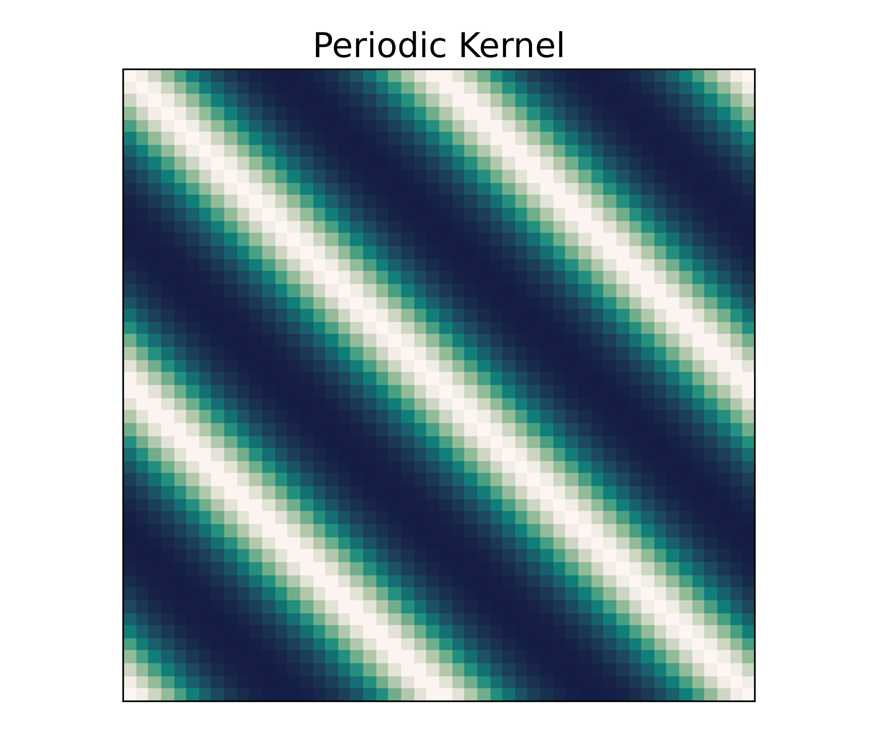
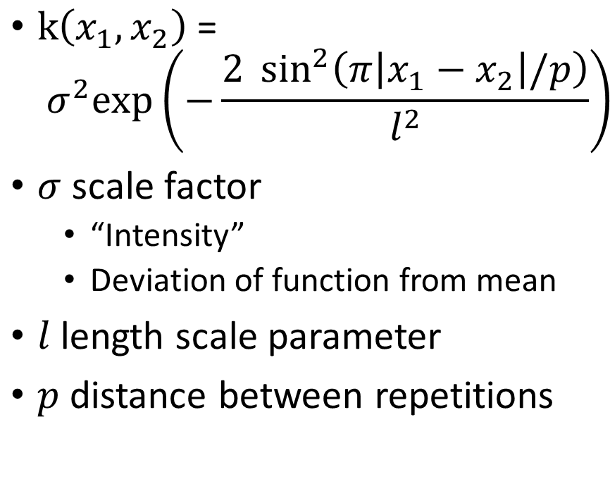
Kernels – Periodic [3]
$\text{k}\left(x_{1},x_{2}\right) \text{=}$ ${ σ}^{2}\text{exp}\left(−\frac{2 \sin^{2}\left(π\left|x_{1}−x_{2}\right|/p\right)}{l^{2}}\right)$
$σ$ scale factor
“Intensity”
Deviation of function from mean
$l$ length scale parameter
$p$ distance between repetitions

Slide 16
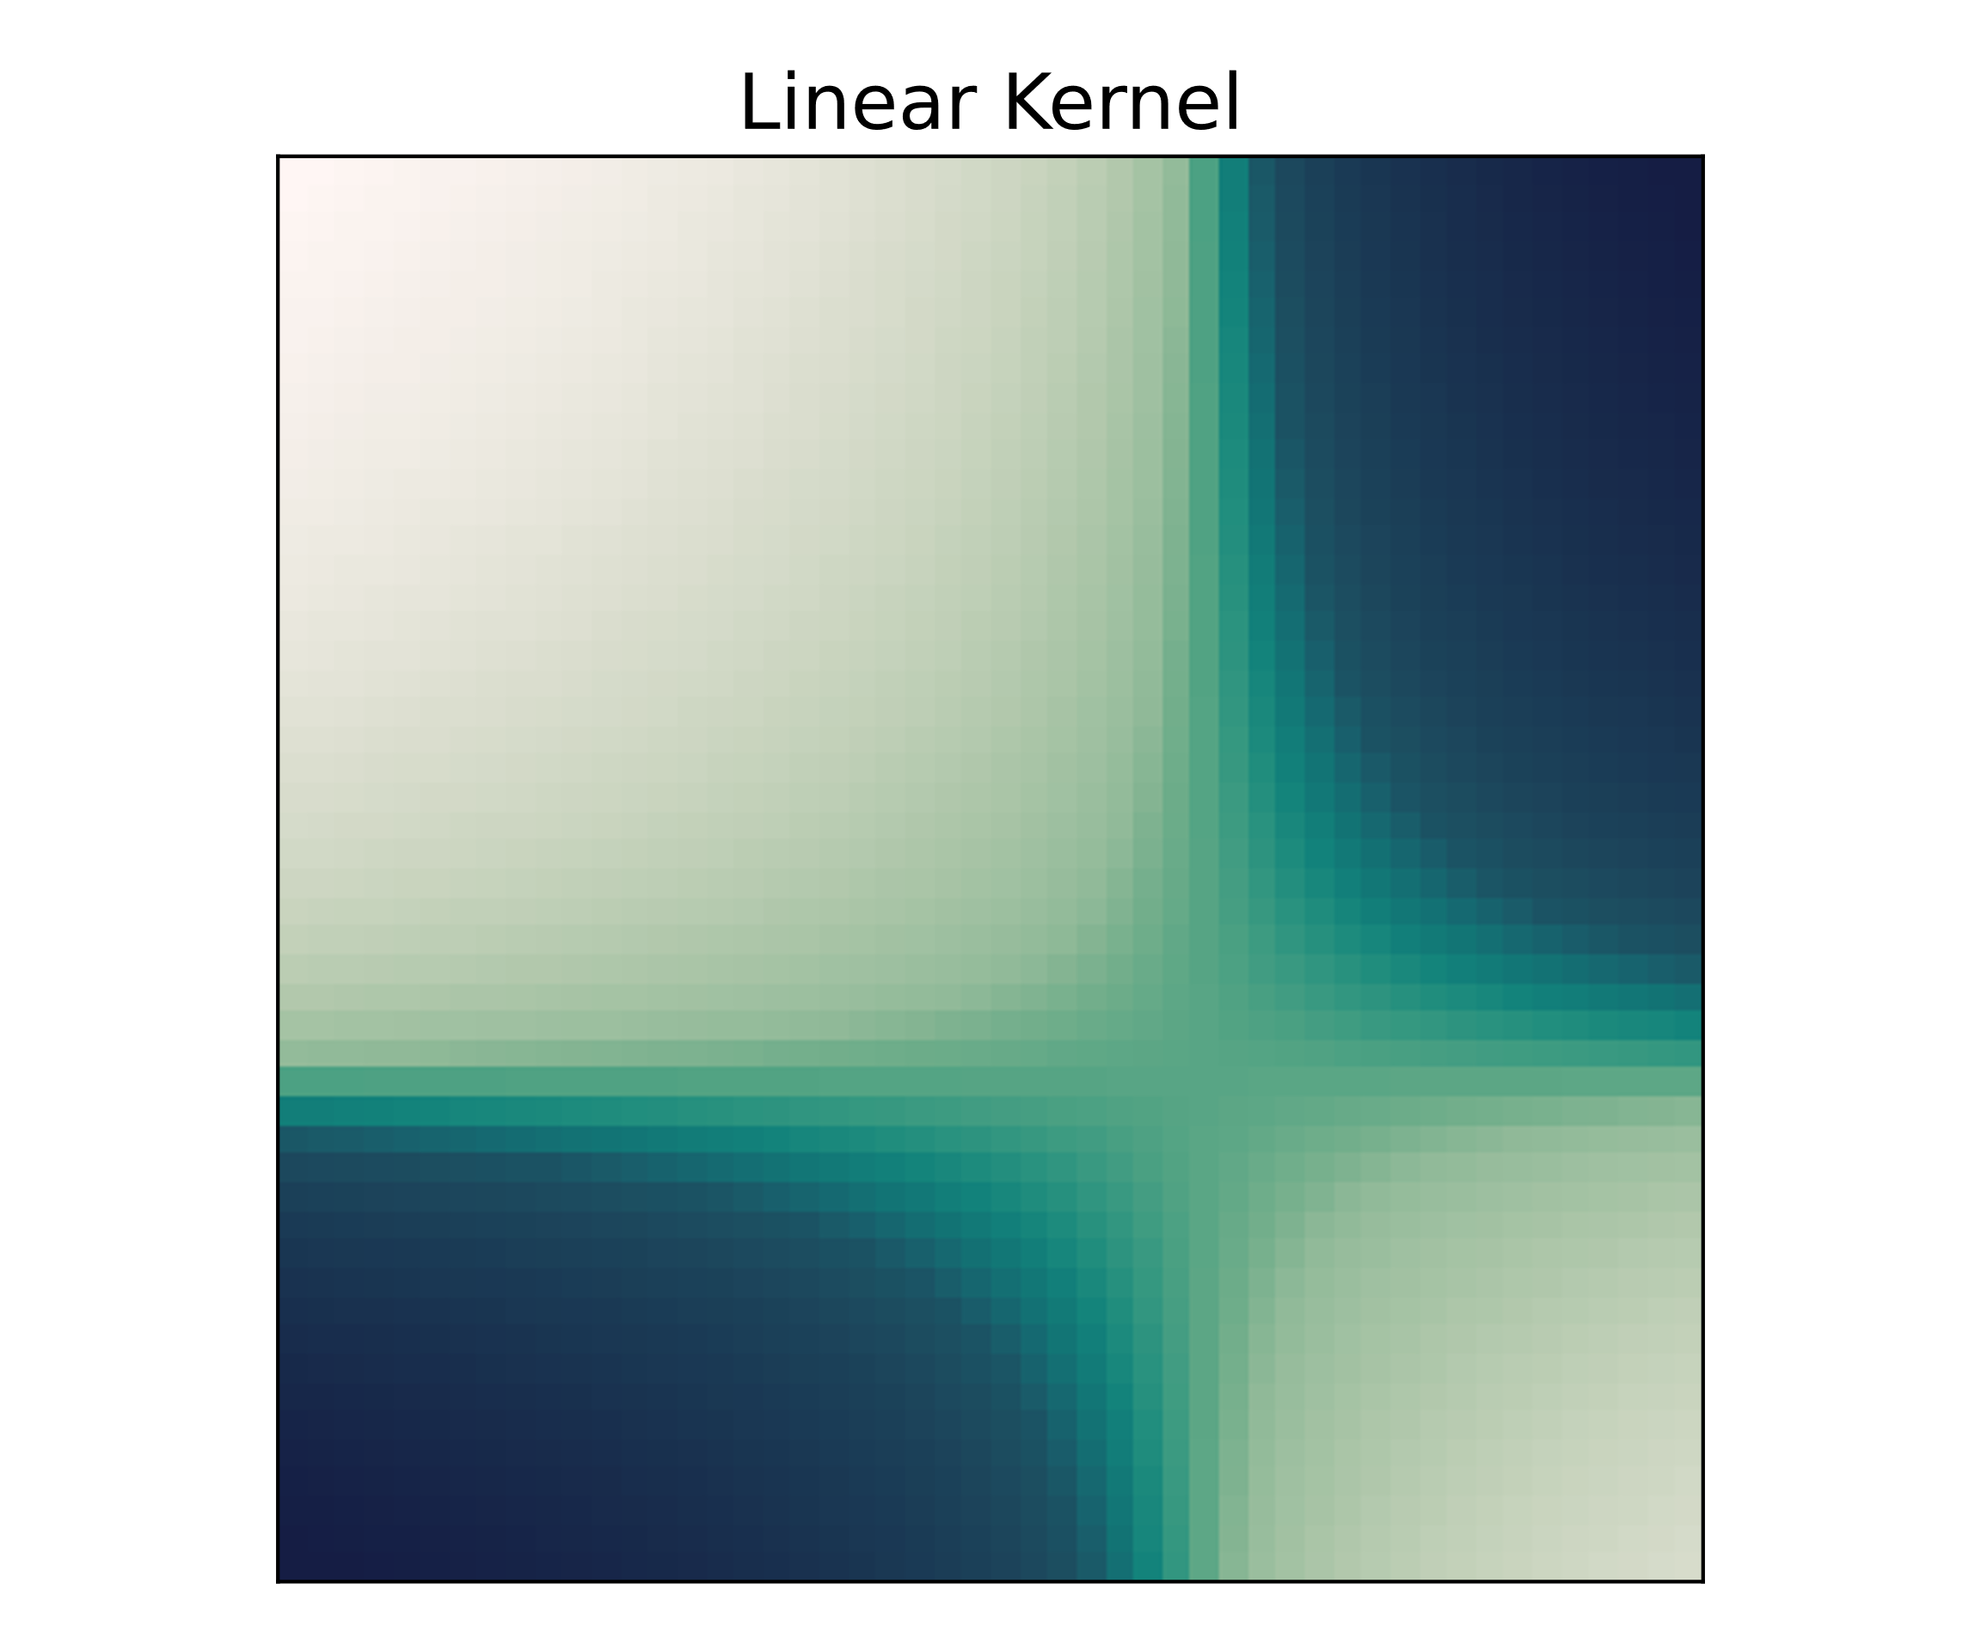
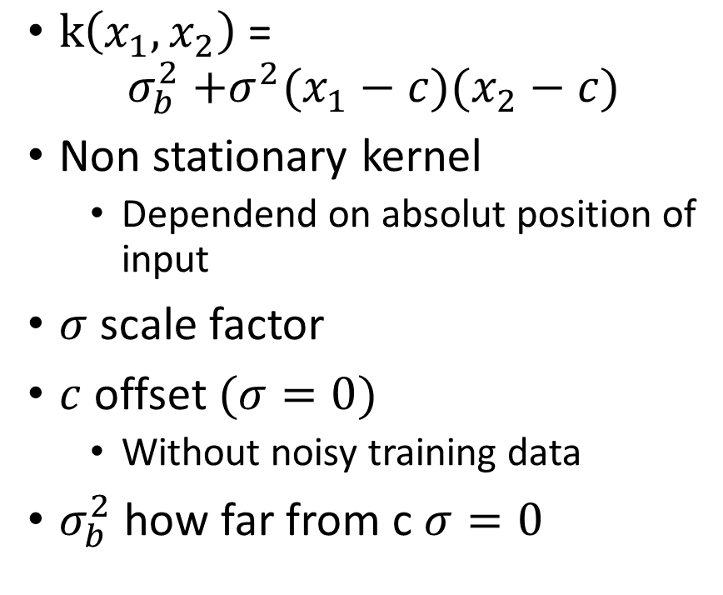
Kernels – Linear [3]
$\text{k}\left(x_{1},x_{2}\right) \text{=}$ $σ_{b}^{2}\text{ +}σ^{2}(x_{1}−c)(x_{2}−c)$
Non stationary kernel
Dependend on absolut position of input
$σ$ scale factor
$c$ offset $(σ=0)$
Without noisy training data
$σ_{b}^{2}$ how far from c $σ=0$

Slide 17
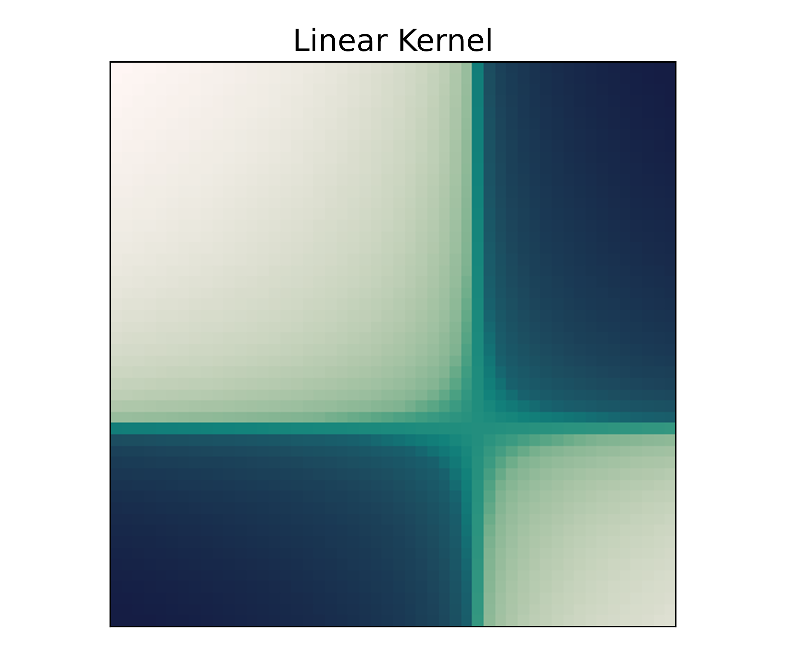
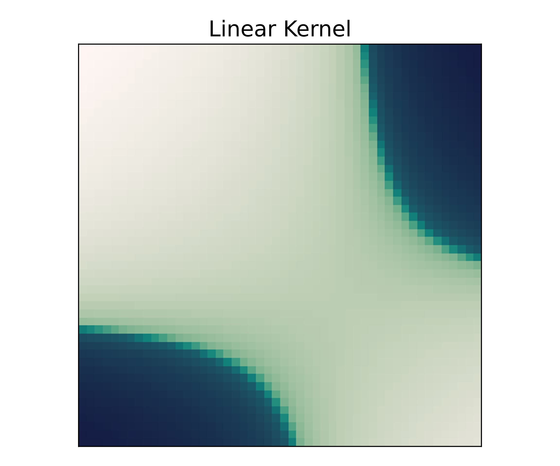


Kernels – Linear
$$σ_{b}=0, c=3,σ=1$$
$$σ_{b}=4, c=3,σ=1$$

Slide 18
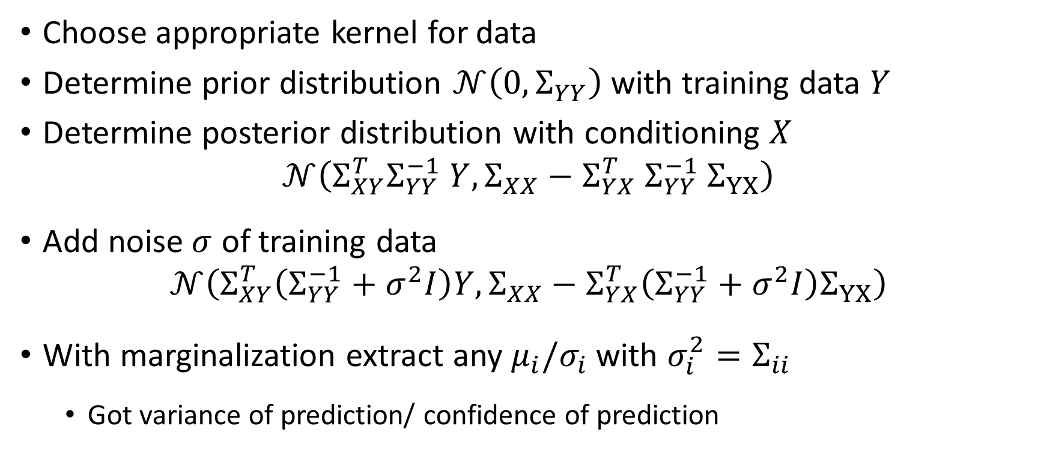
Regression as GP recipe [1,2]
Choose appropriate kernel for data
Determine prior distribution $𝒩\left(0, Σ_{YY}\right)$ with training data $Y$
Determine posterior distribution with conditioning $X$
$$𝒩\left(Σ_{XY}^{T}Σ_{YY}^{−1} Y, Σ_{XX}−Σ_{YX}^{T} Σ_{YY}^{−1} Σ_{YX}\right)$$
Add noise $σ$ of training data
$$𝒩\left(Σ_{XY}^{T}\left(Σ_{YY}^{−1}+σ^{2}I\right)Y, Σ_{XX}−Σ_{YX}^{T}\left(Σ_{YY}^{−1}+σ^{2}I\right)Σ_{YX}\right)$$
With marginalization extract any $μ_{i}/σ_{i}$ with $σ_{i}^{2}=Σ_{ii}$
Got variance of prediction/ confidence of prediction

Slide 19
Live coding

Slide 20
Deep Neural Networks as GP [6]
Consider deep fully connected network with independent and identically distributed (i.i.d) random parameters
Final layer sum of i.i.d. terms
Infinit width network
Central limit theorem (CLT)
Computed function drawn from Gaussian distribution
Replace i.i.d prior over weights + biases with GP over functions
Exact bayesian inference
Need to assume central limit theorem holds
Specified GP called Neural Network Gaussian Process – NNGP

Slide 21
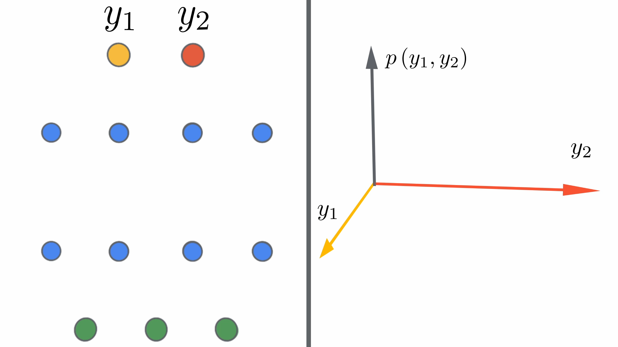
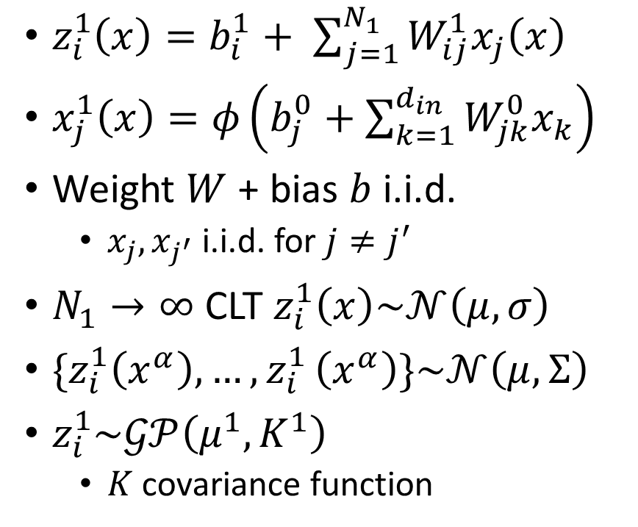
Deep Neural Networks as GP – Single layer[6]
$z_{i}^{1}\left(x\right)=b_{i}^{1}+ \sum_{j=1}^{N_{1}}{W_{ij}^{1}x_{j}\left(x\right)}$
$x_{j}^{1}\left(x\right)=φ\left(b_{j}^{0}+\sum_{k=1}^{d_{in}}{W_{jk}^{0}x_{k}}\right)$
Weight $W$ + bias $b$ i.i.d.
$x_{j},x_{j^{′}}$i.i.d. for $j≠j^{′}$
$N_{1}→∞$ CLT $z_{i}^{1}\left(x\right)\sim 𝒩\left(μ,σ\right)$
$\{z_{i}^{1}\left(x^{α}\right),…{,z}_{i}^{1}\left(x^{α}\right)\}\sim 𝒩\left(μ,Σ\right)$
$z_{i}^{1}\sim 𝒢𝒫\left(μ^{1},K^{1}\right)$
$K$ covariance function
[7]
Notes:
$μ+K$ independent of i

Slide 22
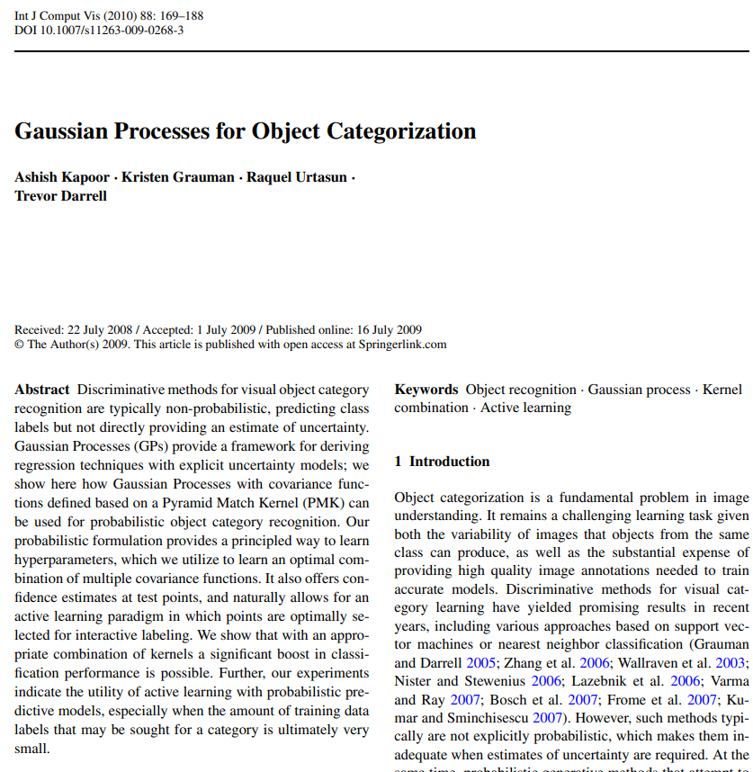
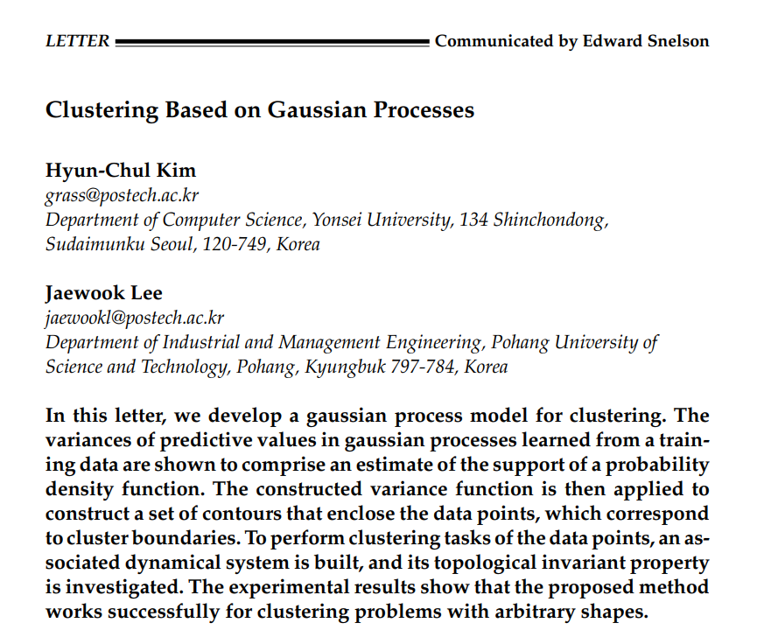

Slide 23
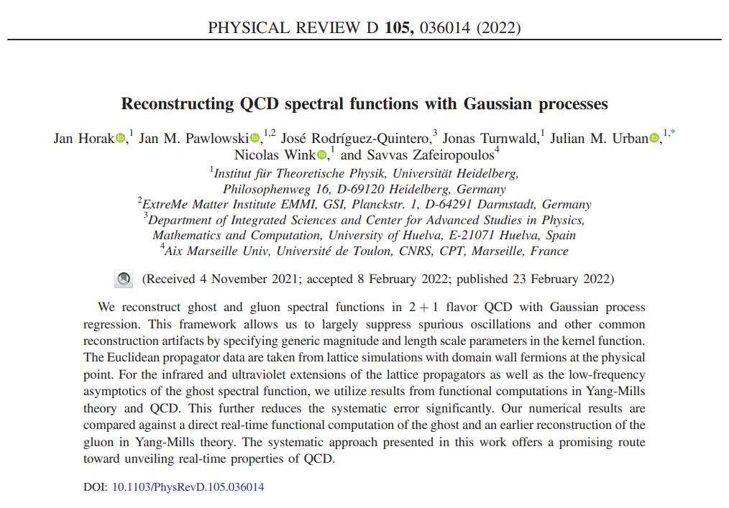
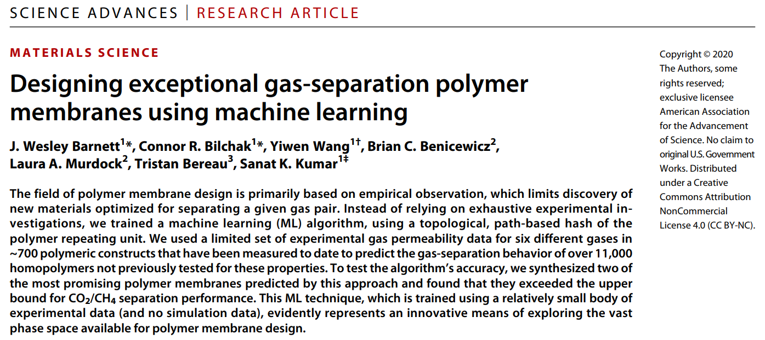

Slide 24
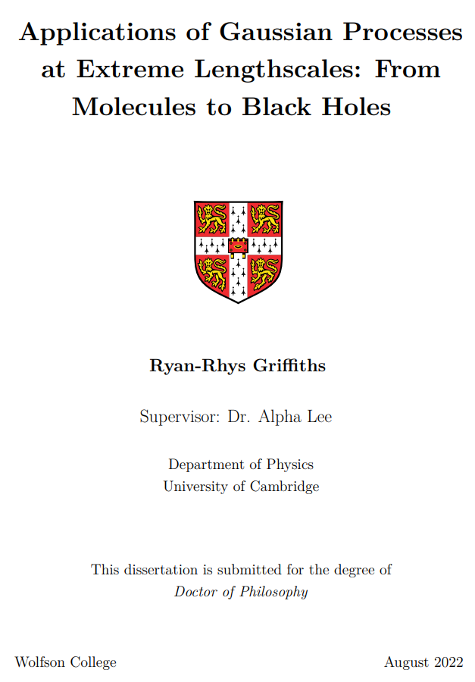
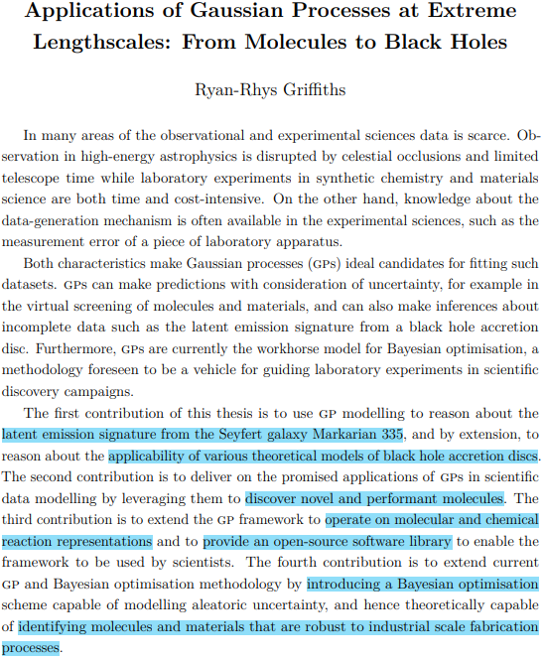

Slide 25
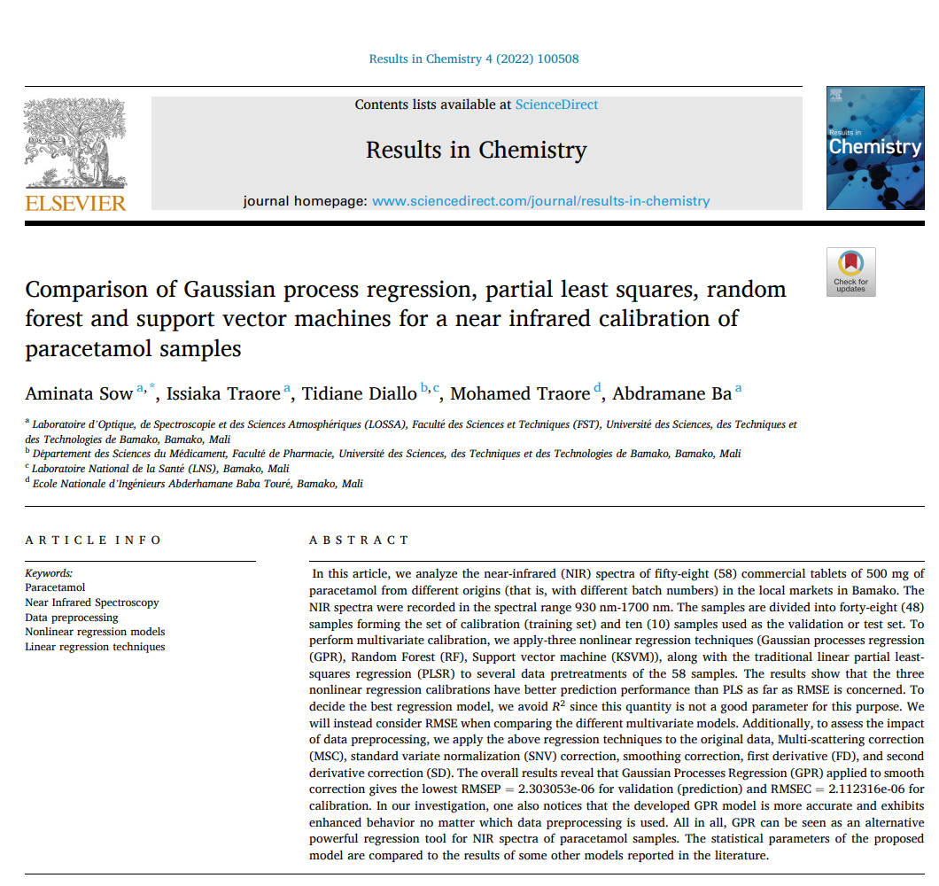

Slide 26
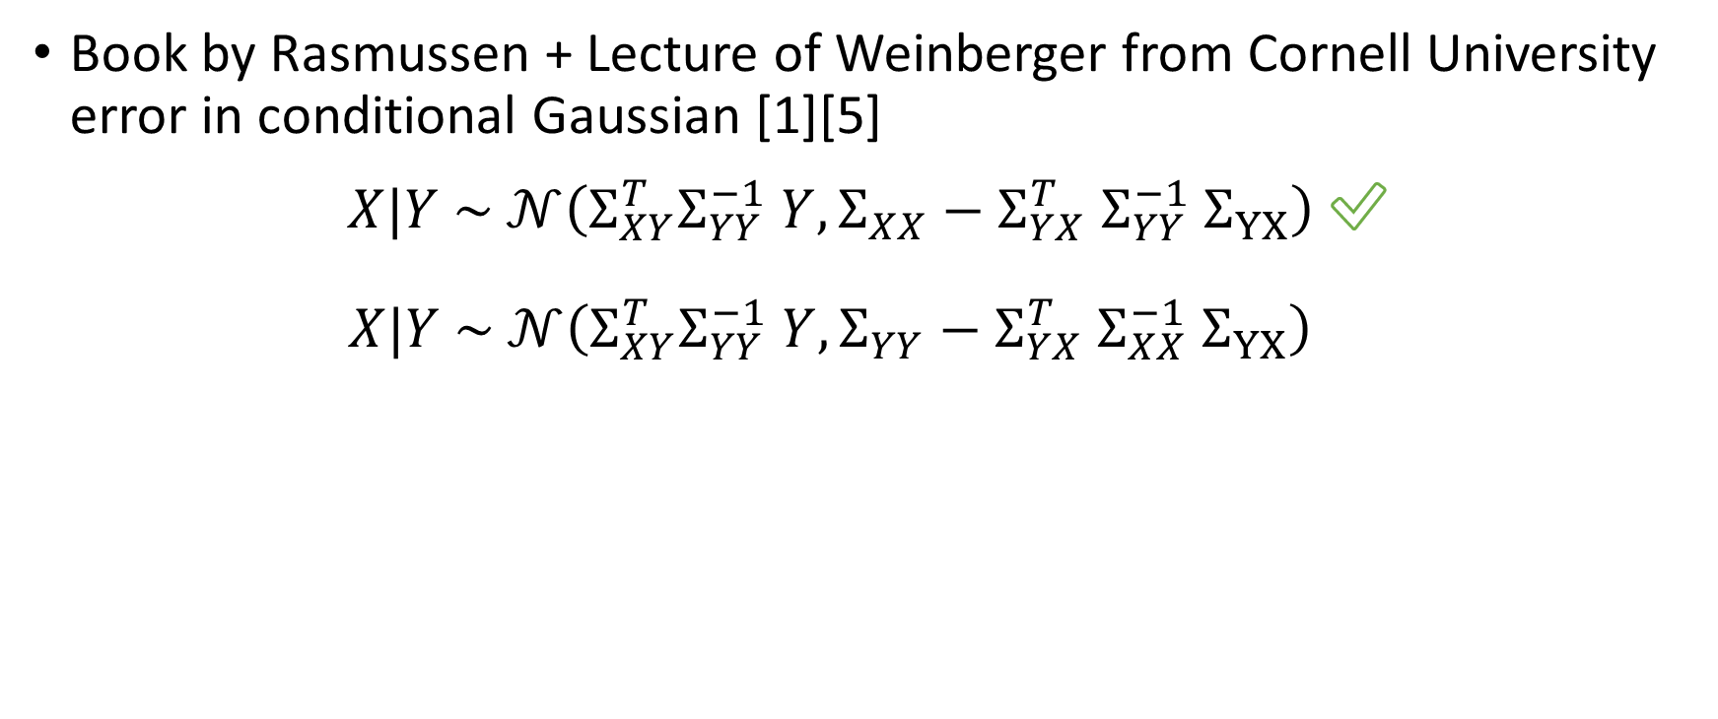
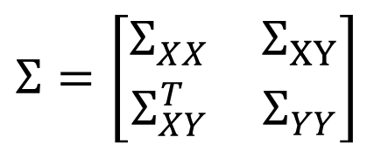
Conclusion – Caveats
Book by Rasmussen + Lecture of Weinberger from Cornell University error in conditional Gaussian [1][5]
$X|Y \sim 𝒩\left(Σ_{XY}^{T}Σ_{YY}^{−1} Y, Σ_{XX}−Σ_{YX}^{T} Σ_{YY}^{−1} Σ_{YX}\right)$ ✅
$X|Y \sim 𝒩\left(Σ_{XY}^{T}Σ_{YY}^{−1} Y, Σ_{YY}−Σ_{YX}^{T} Σ_{XX}^{−1} Σ_{YX}\right)$ ✅
$$Σ=\left[\begin{matrix}Σ_{XX} & Σ_{XY} \\ Σ_{XY}^{T} & Σ_{YY}\end{matrix}\right]$$

Slide 27
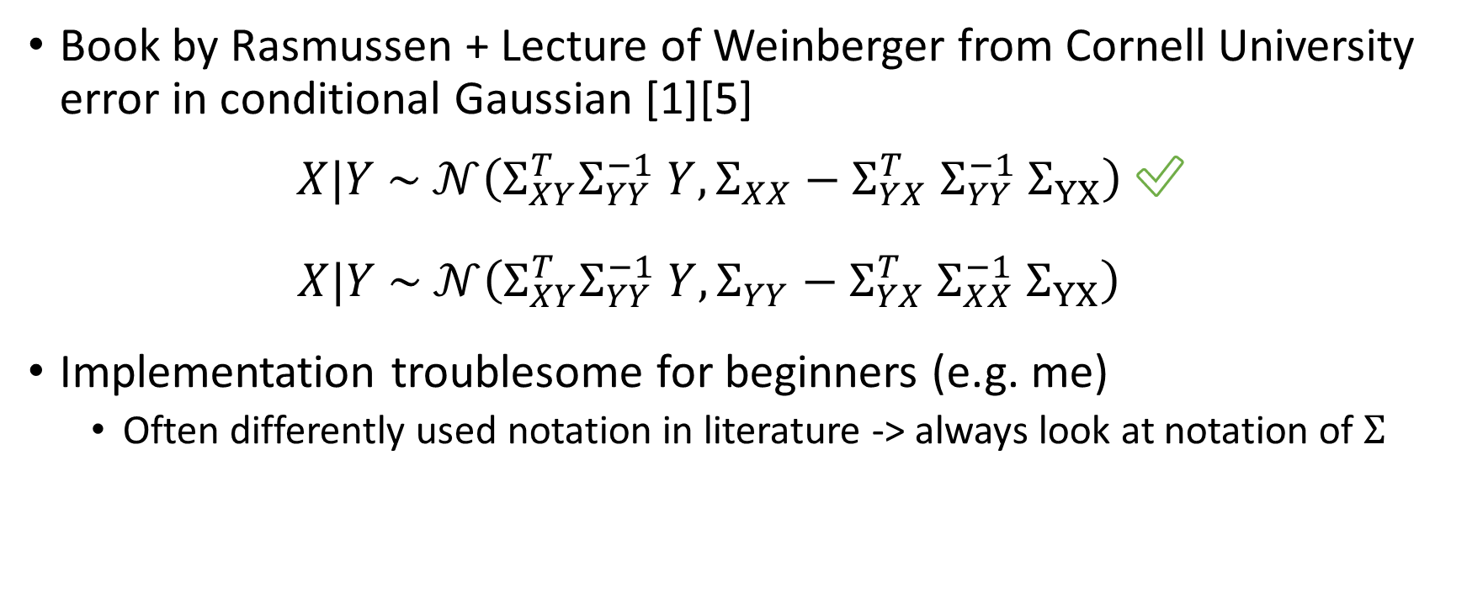
Conclusion – Caveats
Book by Rasmussen + Lecture of Weinberger from Cornell University error in conditional Gaussian [1][5]
$X|Y \sim 𝒩\left(Σ_{XY}^{T}Σ_{YY}^{−1} Y, Σ_{XX}−Σ_{YX}^{T} Σ_{YY}^{−1} Σ_{YX}\right)$ ✅
$X|Y \sim 𝒩\left(Σ_{XY}^{T}Σ_{YY}^{−1} Y, Σ_{YY}−Σ_{YX}^{T} Σ_{XX}^{−1} Σ_{YX}\right)$ ✅
Implementation troublesome for beginners (e.g. me)
Often differently used notation in literature -> always look at notation of $Σ$
$$Σ=\left[\begin{matrix}Σ_{XX} & Σ_{XY} \\ Σ_{XY}^{T} & Σ_{YY}\end{matrix}\right]$$

Slide 28
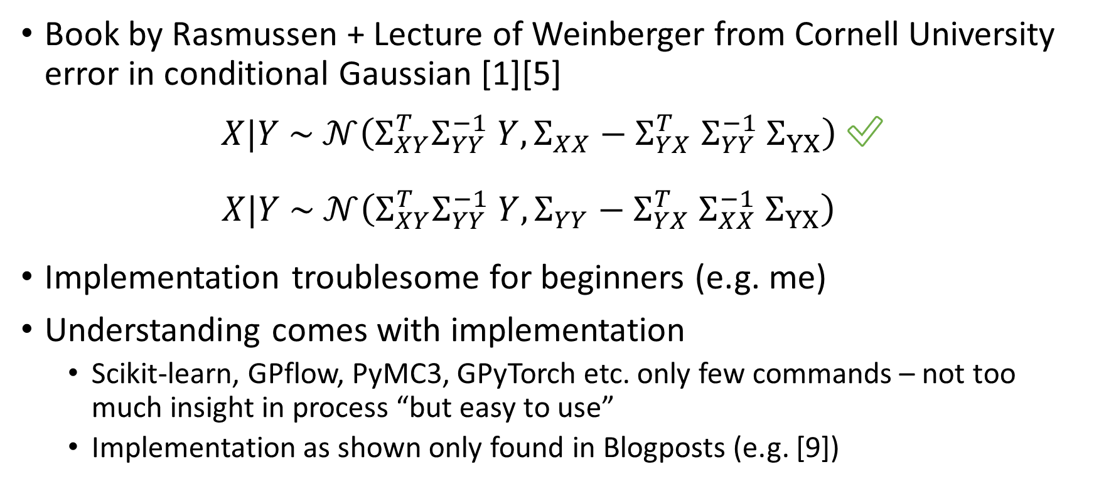
Conclusion – Caveats
Book by Rasmussen + Lecture of Weinberger from Cornell University error in conditional Gaussian [1][5]
$X|Y \sim 𝒩\left(Σ_{XY}^{T}Σ_{YY}^{−1} Y, Σ_{XX}−Σ_{YX}^{T} Σ_{YY}^{−1} Σ_{YX}\right)$ ✅
$X|Y \sim 𝒩\left(Σ_{XY}^{T}Σ_{YY}^{−1} Y, Σ_{YY}−Σ_{YX}^{T} Σ_{XX}^{−1} Σ_{YX}\right)$ ✅
Implementation troublesome for beginners (e.g. me)
Understanding comes with implementation
Scikit-learn, GPflow, PyMC3, GPyTorch etc. only few commands – not too much insight in process “but easy to use”
Implementation as shown only found in Blogposts (e.g. [9])
$$Σ=\left[\begin{matrix}Σ_{XX} & Σ_{XY} \\ Σ_{XY}^{T} & Σ_{YY}\end{matrix}\right]$$

Slide 29
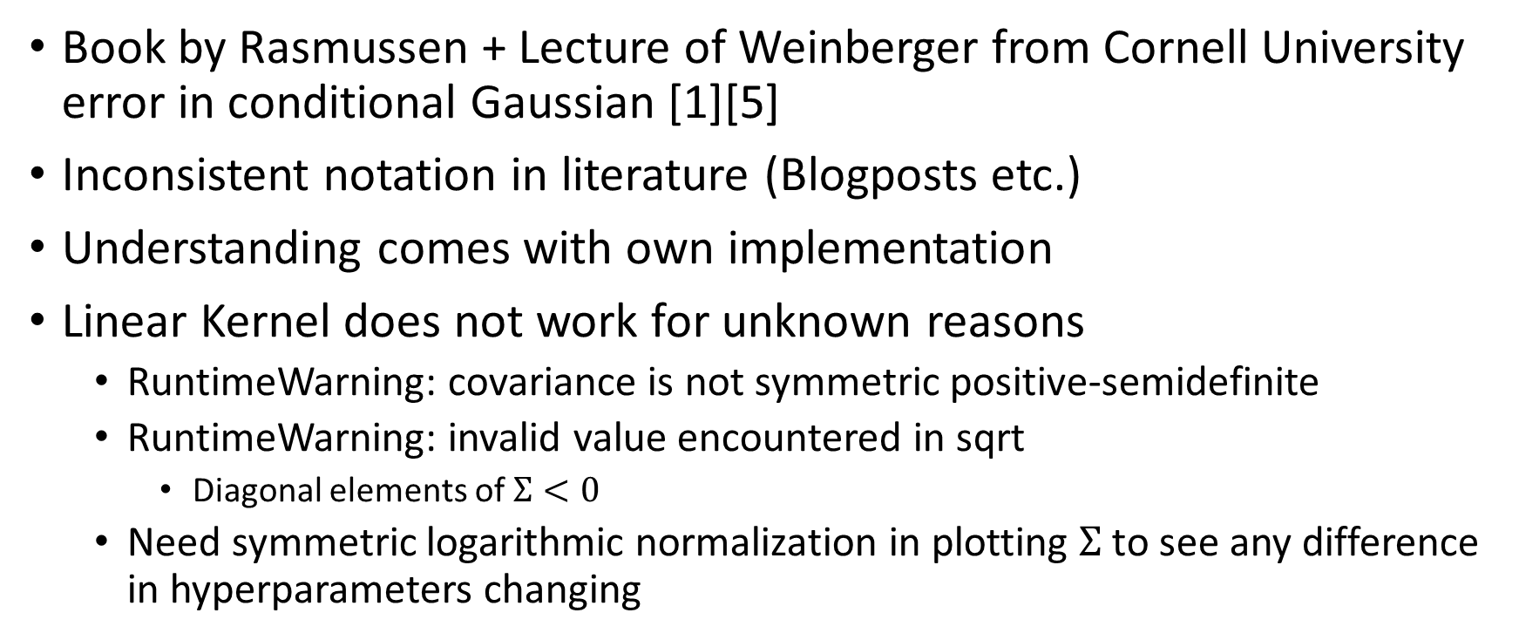
Conclusion – Caveats
Book by Rasmussen + Lecture of Weinberger from Cornell University error in conditional Gaussian [1][5]
Inconsistent notation in literature (Blogposts etc.)
Understanding comes with own implementation
Linear Kernel does not work for unknown reasons
RuntimeWarning: covariance is not symmetric positive-semidefinite
RuntimeWarning: invalid value encountered in sqrt
Diagonal elements of $Σ<0$
Need symmetric logarithmic normalization in plotting $Σ$ to see any difference in hyperparameters changing
Notes:
“If you use just a linear kernel in a GP, you're simply doing Bayesian linear regression, and good news! You can do this in time O(N) instead of O(N3), so you should probably go use software specifically designed for that. “[3]

Slide 30
Conclusion – Caveats
Book by Rasmussen + Lecture of Weinberger from Cornell University error in conditional Gaussian [1][5]
Inconsistent notation in literature (Blogposts etc.)
Understanding comes with own implementation
Linear Kernel does not work for unknown reasons
Concept of test / training data gets smeared due to Bayesian inference

Slide 31
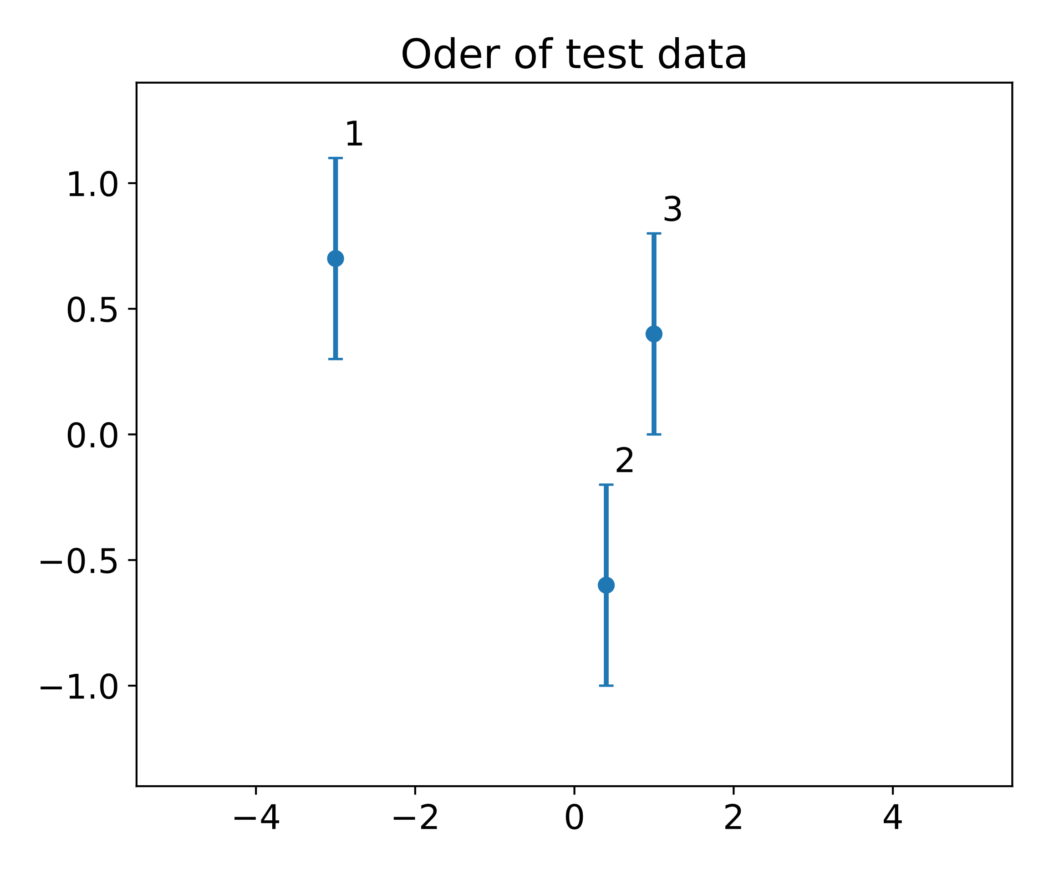
Conclusion – Caveats – Test and Training Data
Concept of test / training data gets smeared
Adding more test data “old” test data gets training data

Slide 32
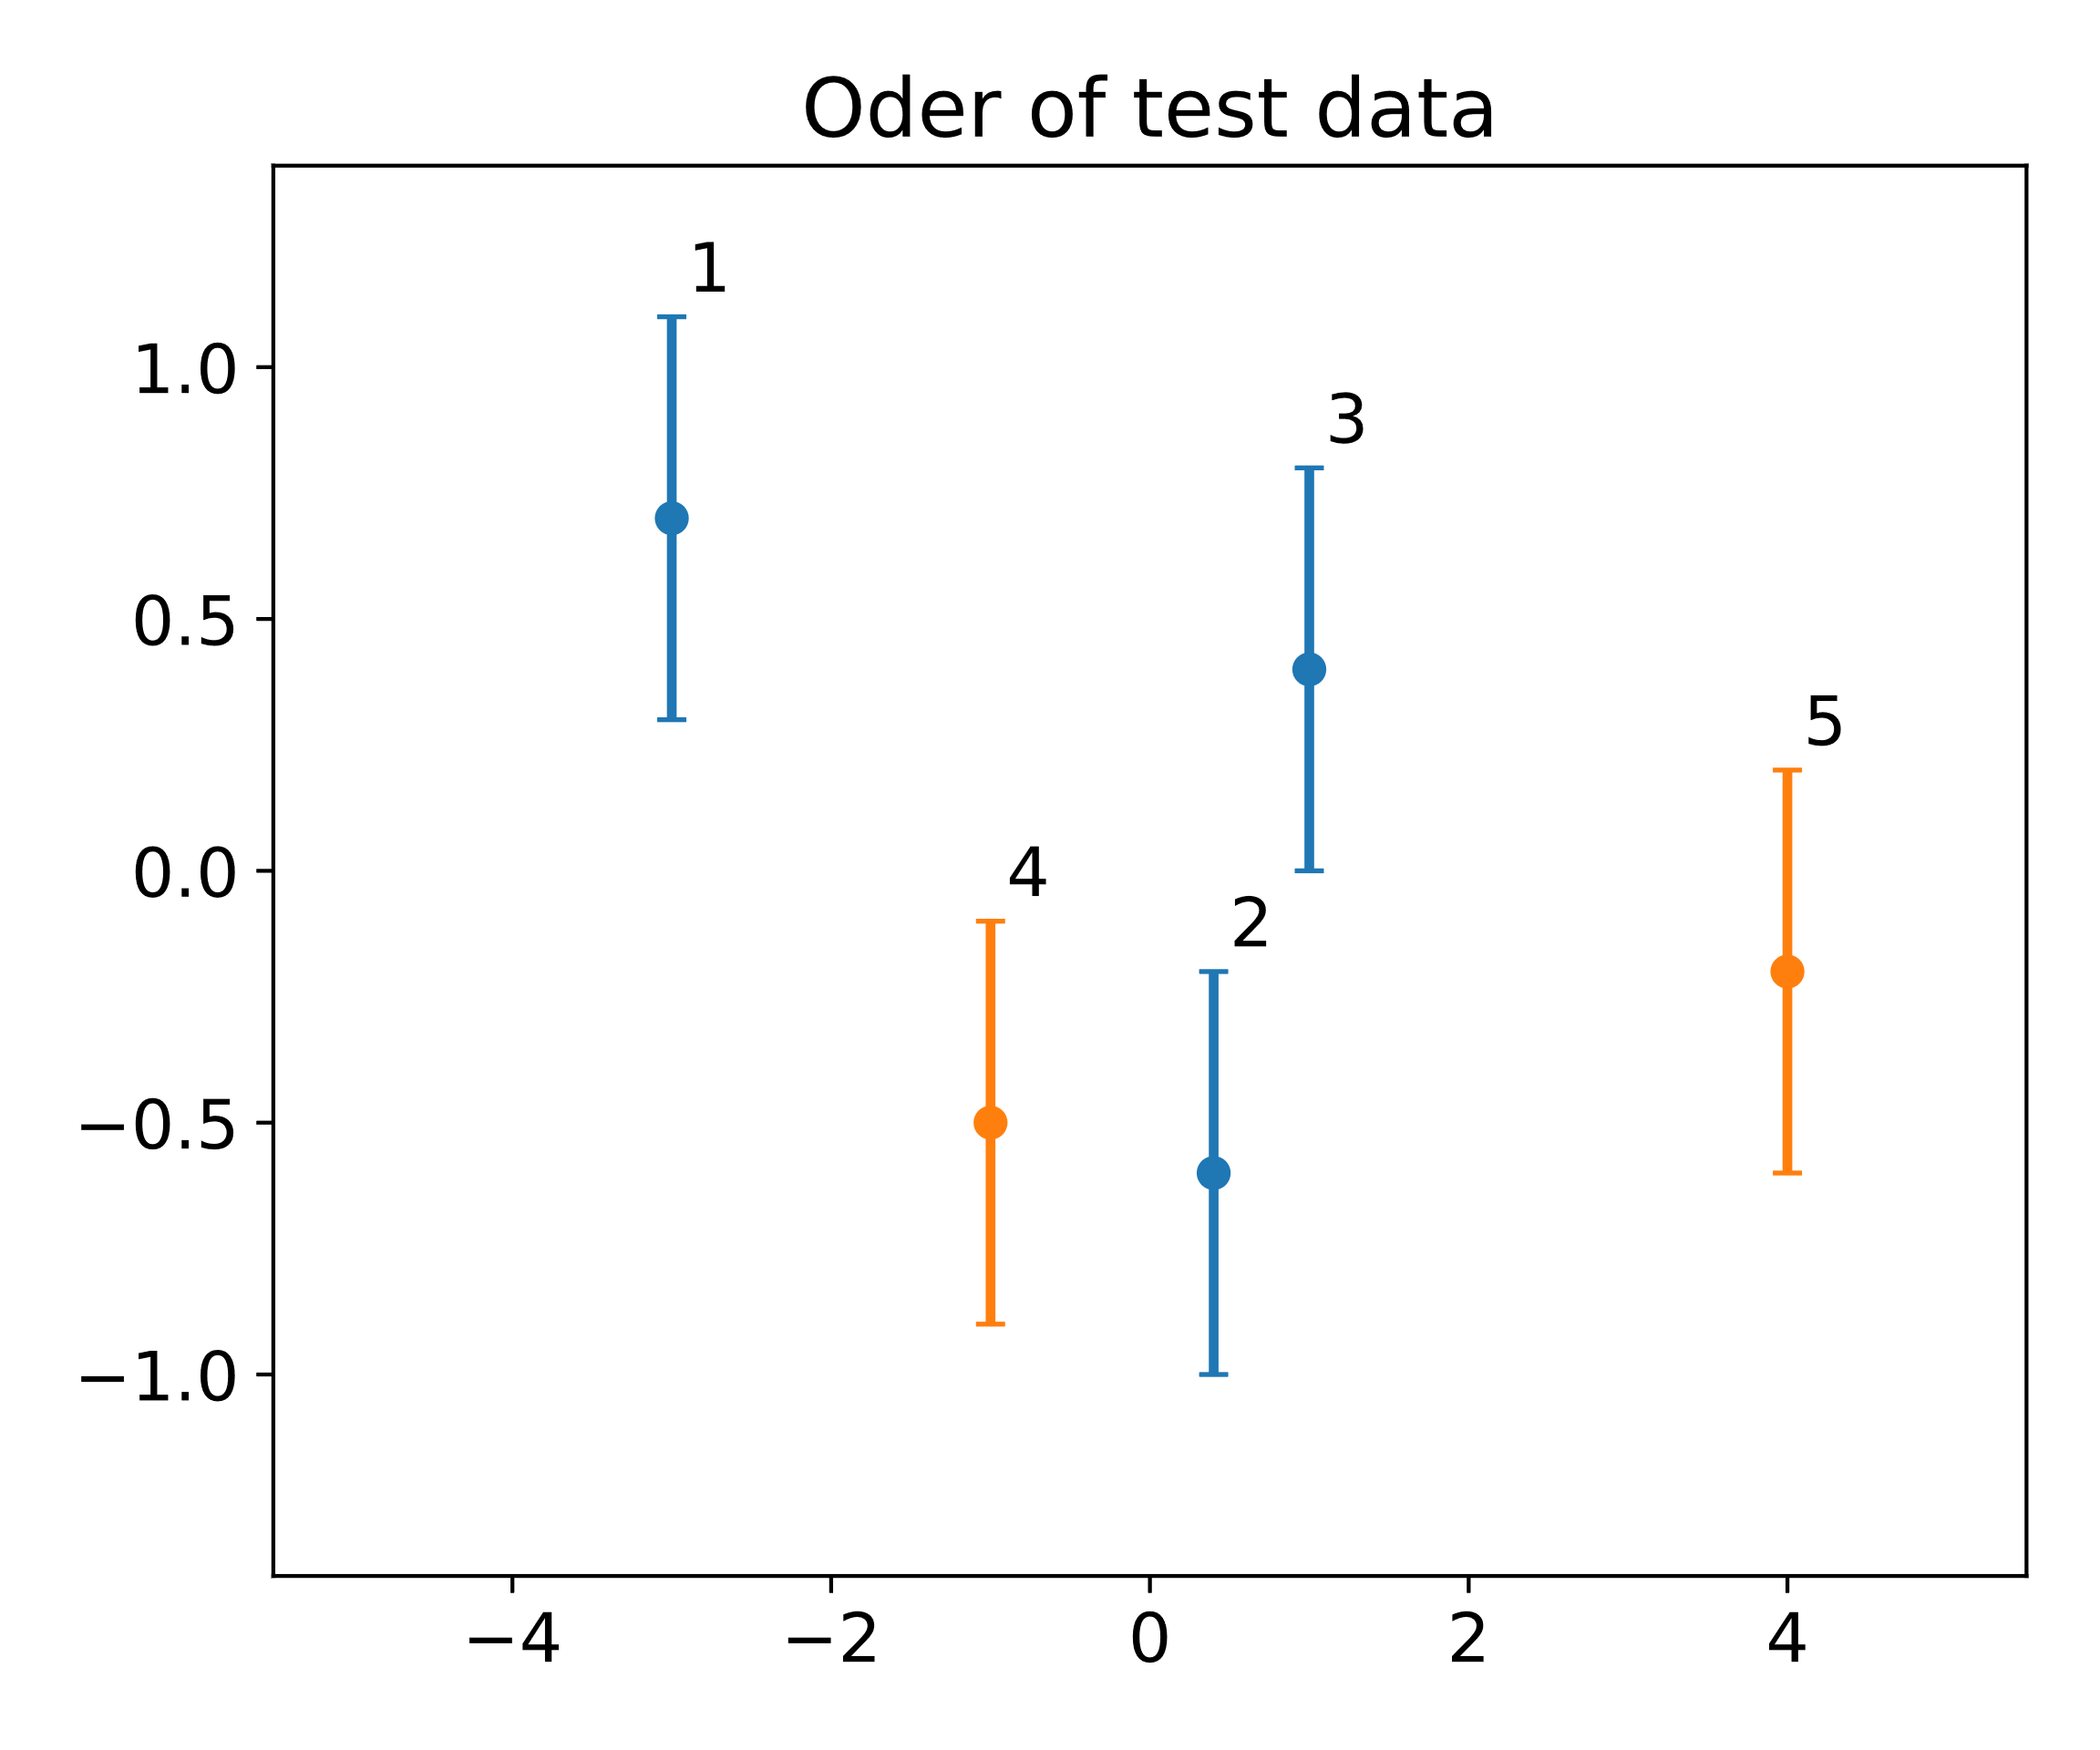
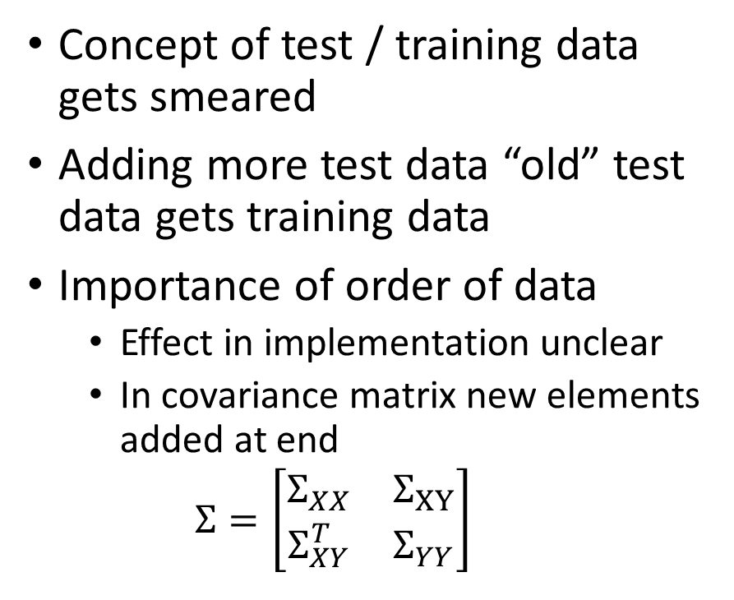
Conclusion – Caveats – Test and Training Data
Concept of test / training data gets smeared
Adding more test data “old” test data gets training data
Importance of order of data
Effect in implementation unclear
In covariance matrix new elements added at end
$$Σ=\left[\begin{matrix}Σ_{XX} & Σ_{XY} \\ Σ_{XY}^{T} & Σ_{YY}\end{matrix}\right]$$

Slide 33
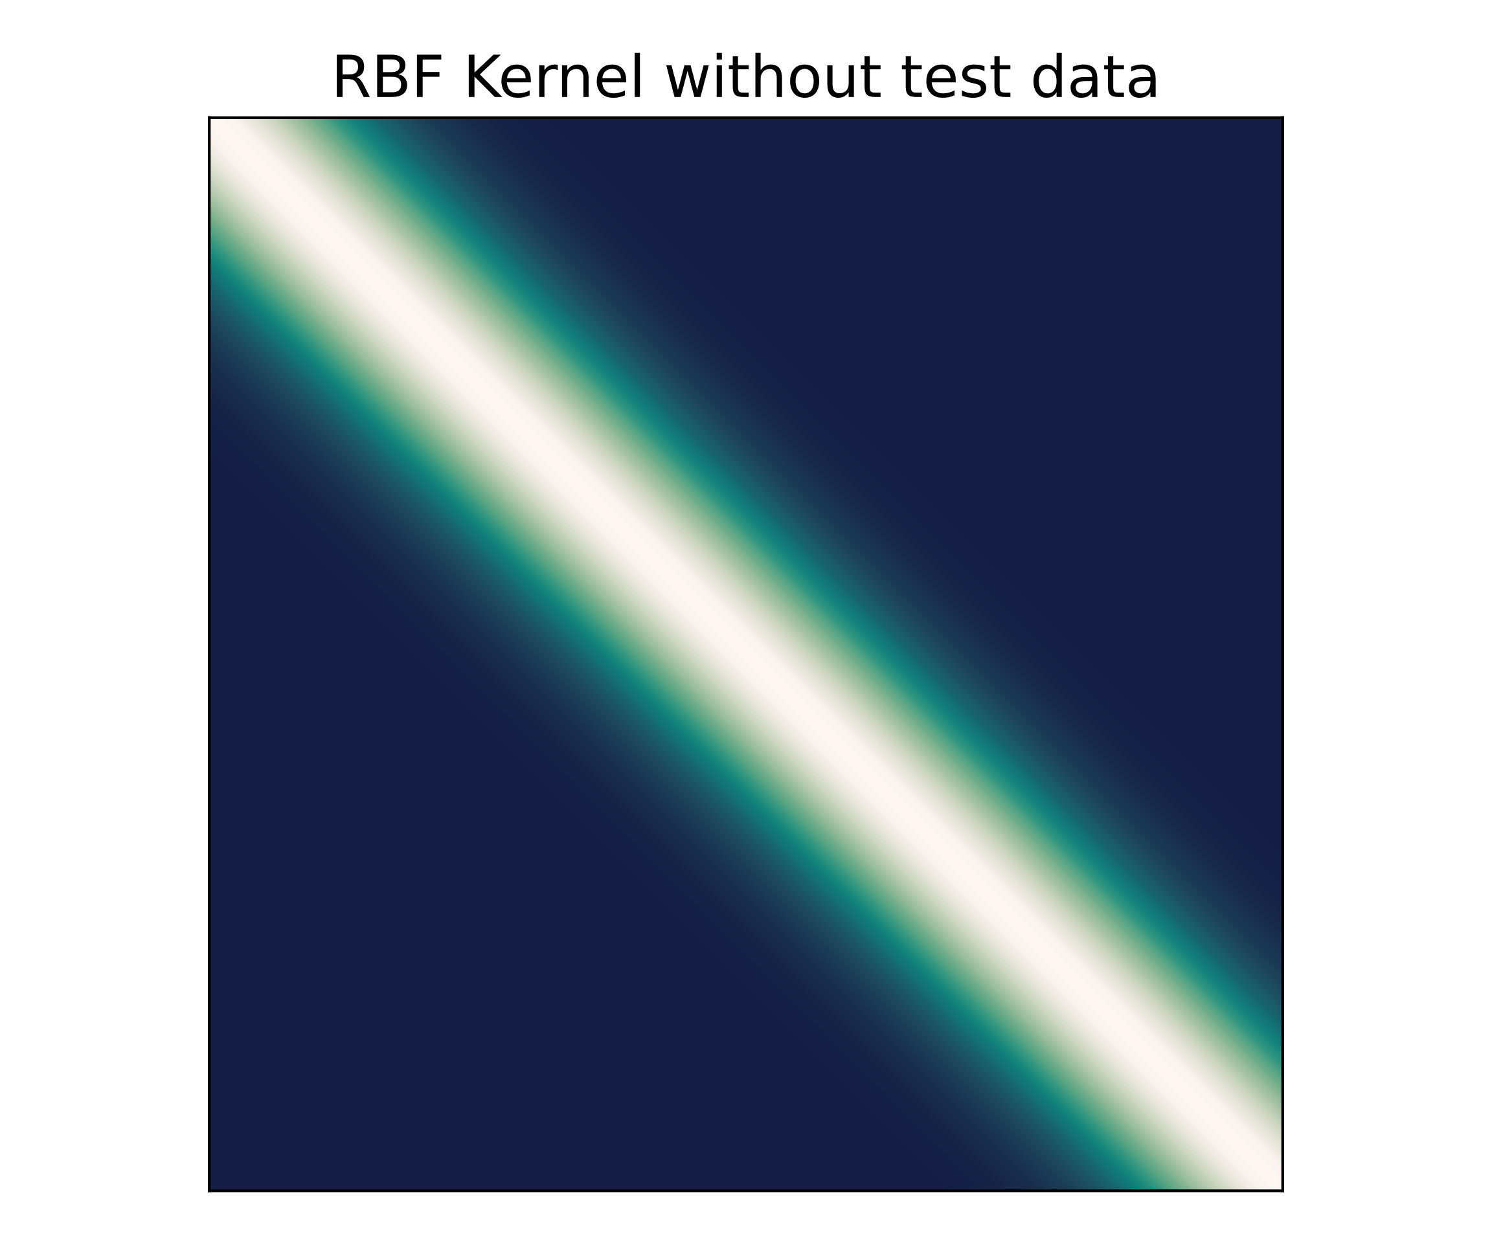
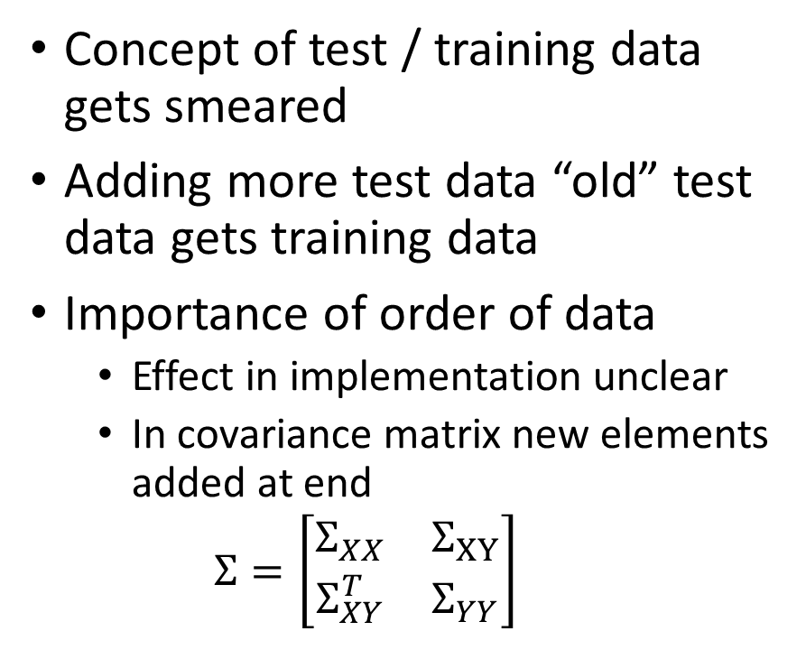
Conclusion – Caveats – Test and Training Data
Concept of test / training data gets smeared
Adding more test data “old” test data gets training data
Importance of order of data
Effect in implementation unclear
In covariance matrix new elements added at end
$$Σ=\left[\begin{matrix}Σ_{XX} & Σ_{XY} \\ Σ_{XY}^{T} & Σ_{YY}\end{matrix}\right]$$

Slide 34
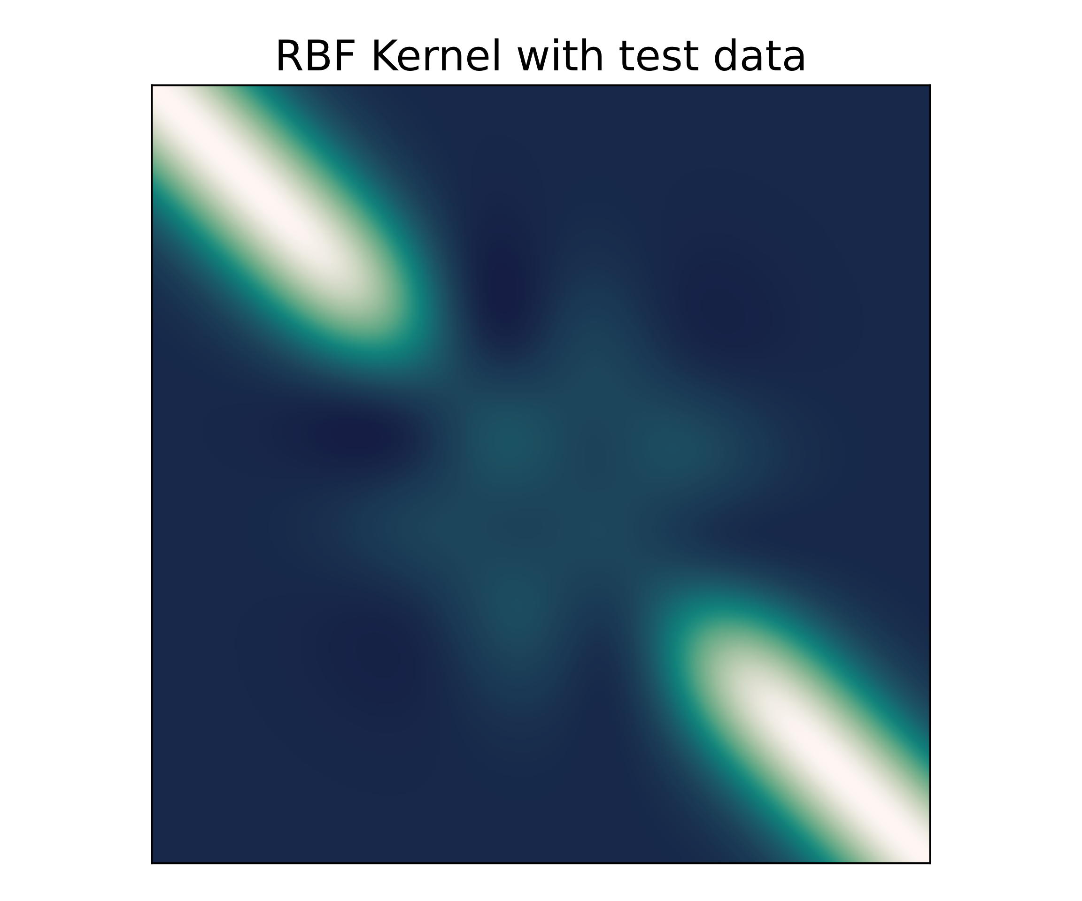
Conclusion – Caveats – Test and Training Data
Concept of test / training data gets smeared
Adding more test data “old” test data gets training data
Importance of order of data
Effect in implementation unclear
In covariance matrix new elements added at end
$$Σ=\left[\begin{matrix}Σ_{XX} & Σ_{XY} \\ Σ_{XY}^{T} & Σ_{YY}\end{matrix}\right]$$

Slide 35
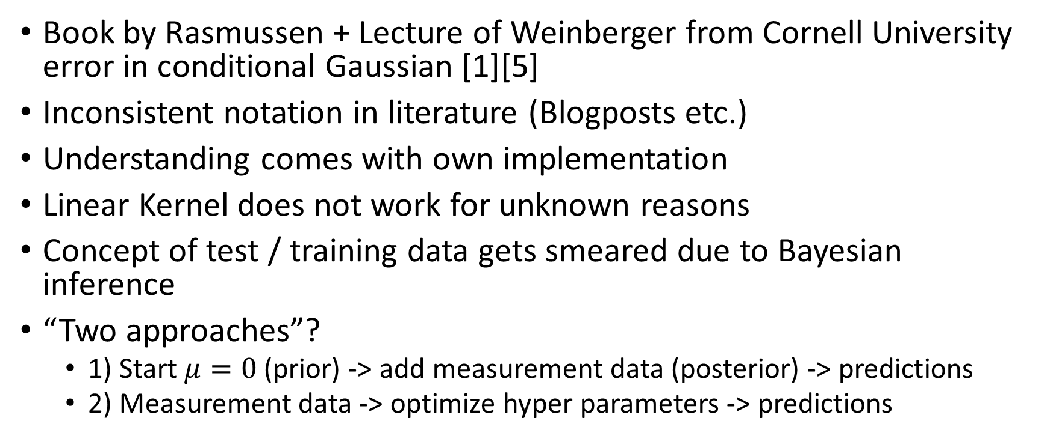
Conclusion – Caveats
Book by Rasmussen + Lecture of Weinberger from Cornell University error in conditional Gaussian [1][5]✅
Inconsistent notation in literature (Blogposts etc.)
Understanding comes with own implementation
Linear Kernel does not work for unknown reasons
Concept of test / training data gets smeared due to Bayesian inference
“Two approaches”?
1) Start $μ=0$ (prior) -> add measurement data (posterior) -> predictions
2) Measurement data -> optimize hyper parameters -> predictions

Slide 36
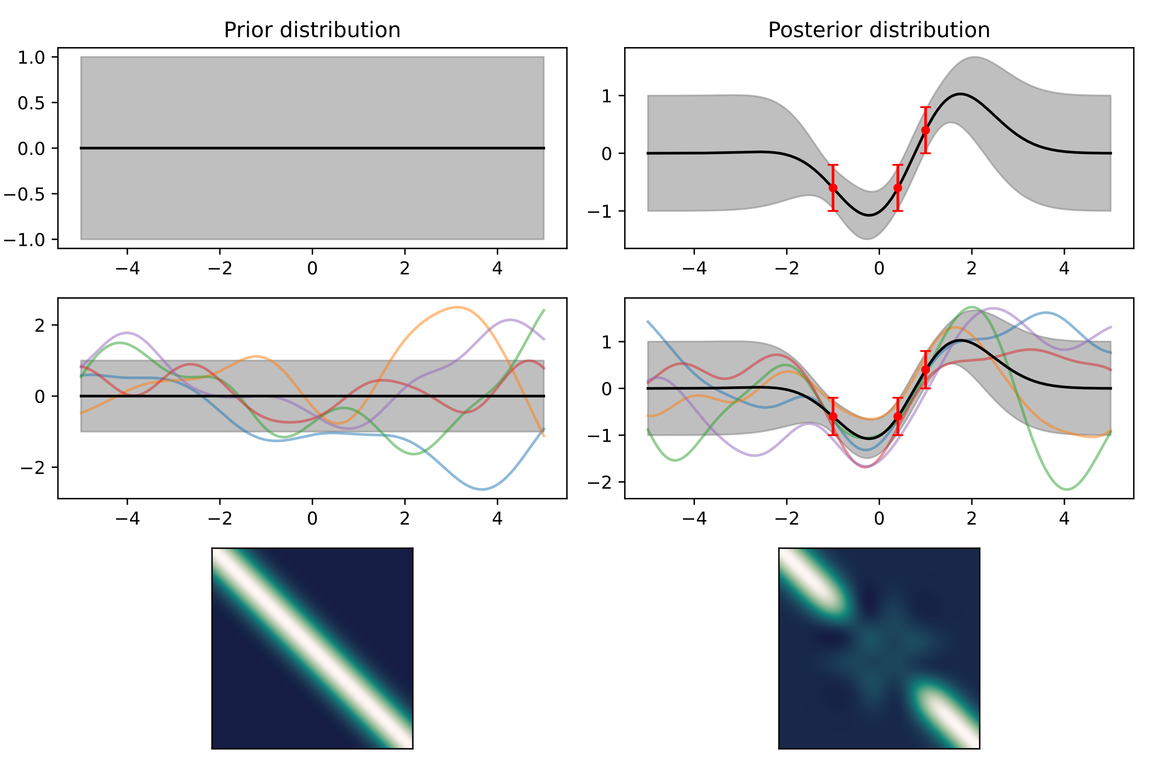
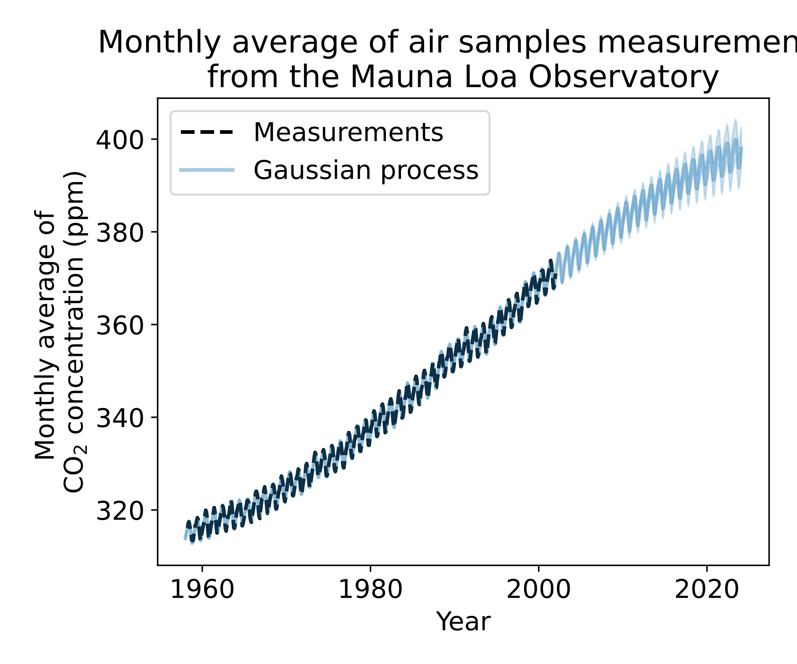
Conclusion – Caveats – “Two approaches”
Approach 1
Approach 2
[4]
[4]
Notes:
Approach 1) not totally clear where to implement hyperparameter optimization!
Approach 2) follows more the classical way of fitting data

Slide 37
Conclusion – Caveats
Book by Rasmussen + Lecture of Weinberger from Cornell University error in conditional Gaussian [1][5]✅
Inconsistent notation in literature (Blogposts etc.)
Understanding comes with own implementation
Linear Kernel does not work for unknown reasons
Concept of test / training data gets smeared due to Bayesian inference
“Two approaches”
Both the same – 1) just for illustration purposes
Notes:
“Two approaches” just because there was a time when I was confused a lot

Slide 38
Conclusion – Caveats
Book by Rasmussen + Lecture of Weinberger from Cornell University error in conditional Gaussian [1][5]✅
Inconsistent notation in literature (Blogposts etc.)
Understanding comes with own implementation
Linear Kernel does not work for unknown reasons
Concept of test / training data gets smeared due to Bayesian inference
“Two approaches”
Hypotheses testing [10]

Slide 39
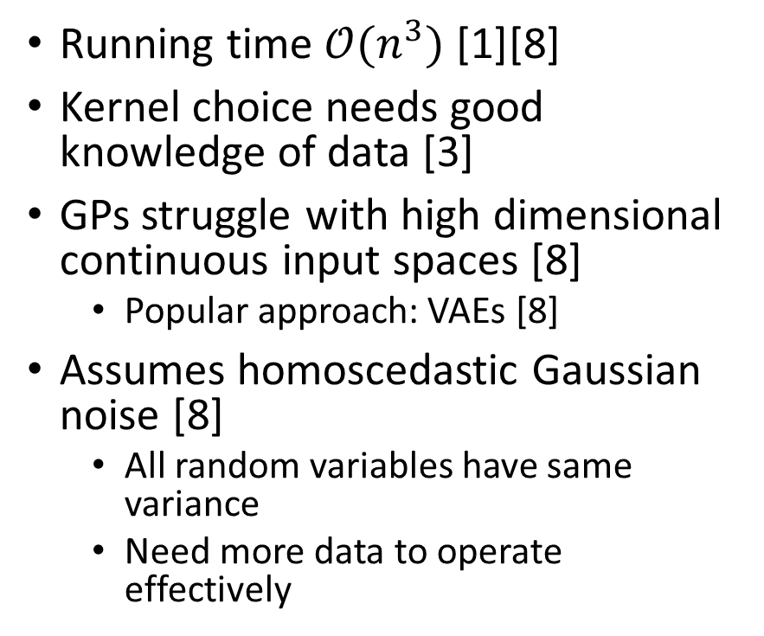
Conclusion
Gained uncertainties of predictions [1]
Full Bayesian inference implemented [8]
Incorporate noise into model
Applications many fields
Running time $𝒪(n^{3})$ [1][8]
Kernel choice needs good knowledge of data [3]
GPs struggle with high dimensional continuous input spaces [8]
Popular approach: VAEs [8]
Assumes homoscedastic Gaussian noise [8]
All random variables have same variance
Need more data to operate effectively
Notes:
Covariance function stipulates that inputs separated by few lengthscales are negligibly correlated

Slide 40
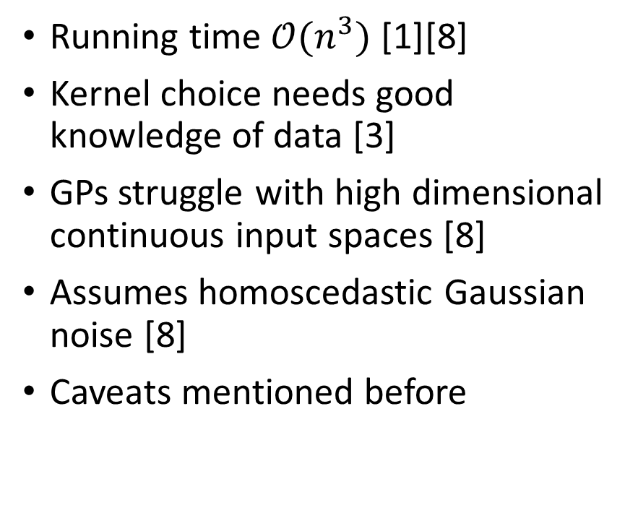
Conclusion
Gained uncertainties of predictions [1]
Full Bayesian inference implemented [8]
Incorporate noise into model
Applications many fields
Running time $𝒪(n^{3})$ [1][8]
Kernel choice needs good knowledge of data [3]
GPs struggle with high dimensional continuous input spaces [8]
Assumes homoscedastic Gaussian noise [8]
Caveats mentioned before
Notes:
Covariance function stipulates that inputs separated by few lengthscales are negligibly correlated

Slide 41
Görtler, et al., "A Visual Exploration of Gaussian Processes“
https://distill.pub/2019/visual-exploration-gaussian-processes/
https://doi.org/10.23915/distill.00017

Slide 42
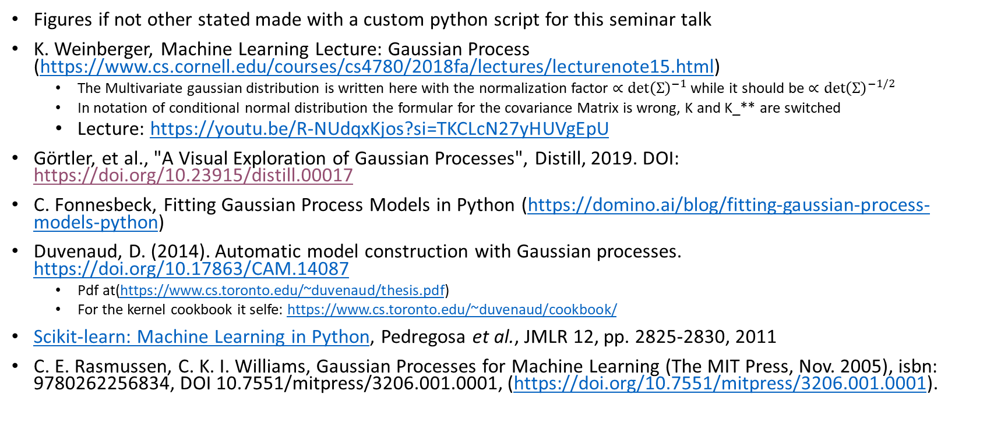
Sources
Figures if not other stated made with a custom python script for this seminar talk
K. Weinberger, Machine Learning Lecture: Gaussian Process (https://www.cs.cornell.edu/courses/cs4780/2018fa/lectures/lecturenote15.html)
The Multivariate gaussian distribution is written here with the normalization factor $∝\det{{\left(Σ\right)}^{−1}}$ while it should be $∝\det{{\left(Σ\right)}^{−1/2}}$
In notation of conditional normal distribution the formular for the covariance Matrix is wrong, K and K_** are switched
Lecture: https://youtu.be/R-NUdqxKjos?si=TKCLcN27yHUVgEpU
Görtler, et al., "A Visual Exploration of Gaussian Processes", Distill, 2019. DOI: https://doi.org/10.23915/distill.00017
C. Fonnesbeck, Fitting Gaussian Process Models in Python (https://domino.ai/blog/fitting-gaussian-process-models-python)
Duvenaud, D. (2014). Automatic model construction with Gaussian processes. https://doi.org/10.17863/CAM.14087
Pdf at(https://www.cs.toronto.edu/~duvenaud/thesis.pdf)
For the kernel cookbook it selfe: https://www.cs.toronto.edu/~duvenaud/cookbook/
Scikit-learn: Machine Learning in Python, Pedregosa et al., JMLR 12, pp. 2825-2830, 2011
C. E. Rasmussen, C. K. I. Williams, Gaussian Processes for Machine Learning (The MIT Press, Nov. 2005), isbn: 9780262256834, DOI 10.7551/mitpress/3206.001.0001, (https://doi.org/10.7551/mitpress/3206.001.0001).

Slide 43
Sources
Lee, Jaehoon; Bahri, Yasaman; Novak, Roman; Schoenholz, Samuel S.; Pennington, Jeffrey; Sohl-Dickstein, Jascha (2017). "Deep Neural Networks as Gaussian Processes". International Conference on Learning Representations. arXiv:1711.00165
Samuel S. Schoenholz, Fast and Easy Infinitely Wide Networks with Neural Tangents https://blog.research.google/2020/03/fast-and-easy-infinitely-wide-networks.html
Kim H-C, Lee J. Clustering Based on Gaussian Processes. Neural computation. 2007;19(11):3088-3107.
Kapoor, A., Grauman, K., Urtasun, R. et al. Gaussian Processes for Object Categorization. Int J Comput Vis 88, 169–188 (2010). https://doi.org/10.1007/s11263-009-0268-3
J. Wesley Barnett et al., Designing exceptional gas-separation polymer membranes using machine learning. Sci. Adv.6,eaaz4301(2020).DOI: https://doi.org/10.1126/sciadv.aaz4301
Griffiths, R.-R. (2022). Applications of Gaussian Processes at Extreme Lengthscales: From Molecules to Black Holes [Apollo - University of Cambridge Repository]. https://doi.org/10.17863/CAM.93643
Horak J, Pawlowski JM, Rodríguez-Quintero J, et al. Reconstructing QCD spectral functions with Gaussian processes. Physical review. 2022;105:1-12. doi: https://doi.org/10.1103/PhysRevD.105.036014.
Sow A, Traore I, Diallo T, Traore M, Ba A. Comparison of Gaussian process regression, partial least squares, random forest and support vector machines for a near infrared calibration of paracetamol samples. Results in Chemistry. 2022;4:100508.

Slide 44
Sources
A. Benavoli, F. Mangili, presented at the Proceedings of the Eighteenth International Conference on Artificial Intelligence and Statistics, ed. by G. Lebanon, S. V. N. Vishwanathan, vol. 38, pp. 74–82, (https://proceedings.mlr.press/v38/benavoli15.html).
Used as: [10] Alessio Benavoli, Francesca Mangili, PMLR 38:74-82, 2015. (https://proceedings.mlr.press/v38/benavoli15.html).

